Slide 1
Sets, logic, combinatorics, simultaneous equations, matrices algebra, number, probability

Slide 2
Sets
Power set of set A is a set of all subsets of A.
Cardinality of power set is 2^{n}, where n is cardinality of A.

Slide 3
Union of sets A and B is a set, which includes all elements of A and all elements of B.

Slide 4
Intersection of sets A and B is a set, which includes all elements, which are both in A and B.

Slide 5
Cardinality of union of A and B is equal to cardinality of A + cardinality of B - cardinality of intersection of A and B.

Slide 6
A – B means all elements which are in A but NOT in B.

Slide 7
Sets operations are similar to logical operations:
NOT for sets is NOT for logic,
intersection for sets is AND for logic,
union for sets is OR for logic.

Slide 8
Logic
Compound propositions include 2 or more propositions.

Slide 9
Tautology: True (for any truth values of their variables)
Contradiction: False (for any truth values of their variables)

Slide 10
P OR NOT P is a tautology.
P AND NOT P is a contradiction.

Slide 11
IFF means if and only if:
If you study hard (H), then you will be rich (R) H → R and if you are rich (R), then you must have studied hard (H) R → H.
This means that if and only if you study hard (H), then you will be rich (R) H←→R

Slide 12
The truth table for IFF is:
H | R | H if and only if R
0 | 0 | 1
0 | 1 | 0
1 | 0 | 0
1 | 1 | 1

Slide 13
H → R
Converse is: R → H
Inverse is: NOT H → NOT R
Contrapositive is: NOT R → NOT H

Slide 14
Question:
Compare truth tables of implication, conversion, inversion, contraposition.

Slide 15
Predicate is logical function.
Example x > 5, this true if x > 5 and false otherwise.
We proved by induction for predicate P(n).

Slide 16
If I am in Jakarta then I am on Java, if I am on Java then I am in Indonesia, therefore, if I am in Jakarta then I am in Indonesia.
Indonesia includes Java, Java includes Jakarta.

Slide 17
Argument
All humans are mammals.
I am a human; therefore, I am a mammal.

Slide 18
Incorrect argument:
All humans are mammals.
I am a mammal; therefore, I am a human.

Slide 19
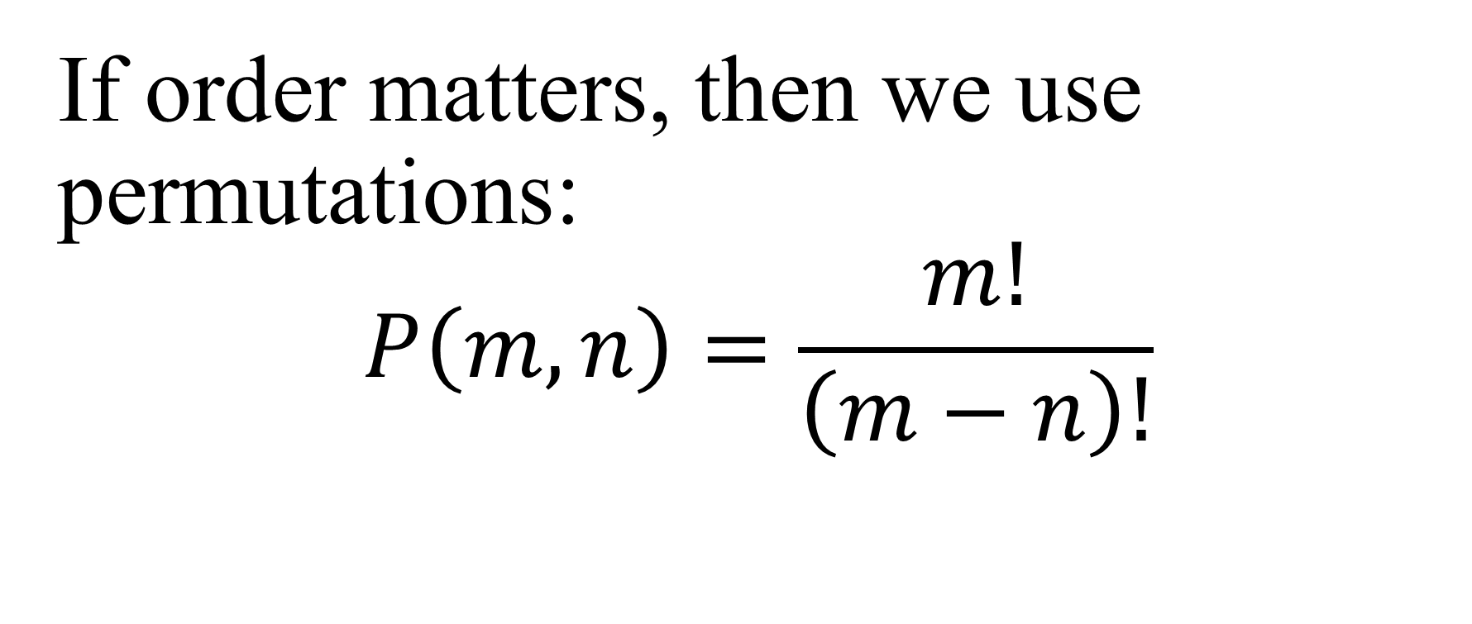
Combinatorics
If order matters, then we use permutations:
$$P\left(m,n\right)=\frac{m!}{\left(m−n\right)!}$$

Slide 20
Question:
Calculate number of permutations L out of T: P(T,L).

Slide 21
I have million (10⁶) options for my 6-digit pin-number.

Slide 22
Question:
How many options are for L decimal digits password?

Slide 23
Simultaneous equations
x and y are unknows variables, we must find they from solving simultaneous equations.
a, b, c, d, e, f are known numbers.

Slide 24
ax+by = c
dx+ey = f

Slide 25
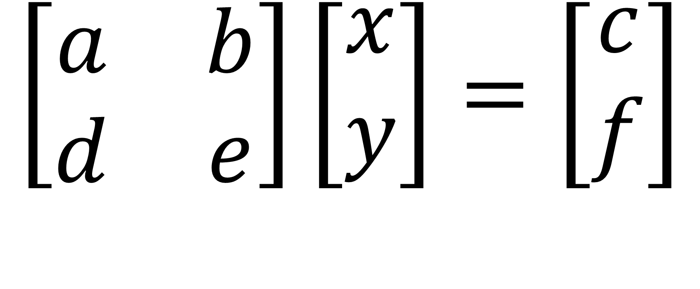
$$\left[\begin{matrix}a & b \\ d & e\end{matrix}\right]\left[\begin{matrix}x \\ y\end{matrix}\right]=\left[\begin{matrix}c \\ f\end{matrix}\right]$$

Slide 26

Substitution: $y=\frac{c−ax}{b}$

Slide 27
Elimination:
eax + eby = ec
bdx + bey = bf

Slide 28
eax – bdx = ec – bf
(ea– bd)x= ec – bf

Slide 29
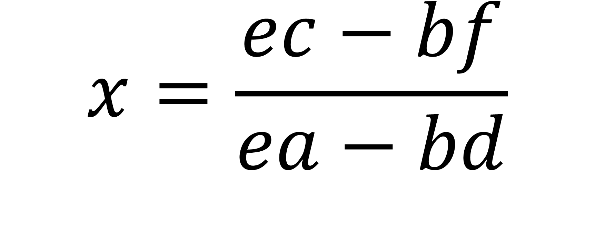
$$x=\frac{ec−bf}{ea−bd}$$

Slide 30
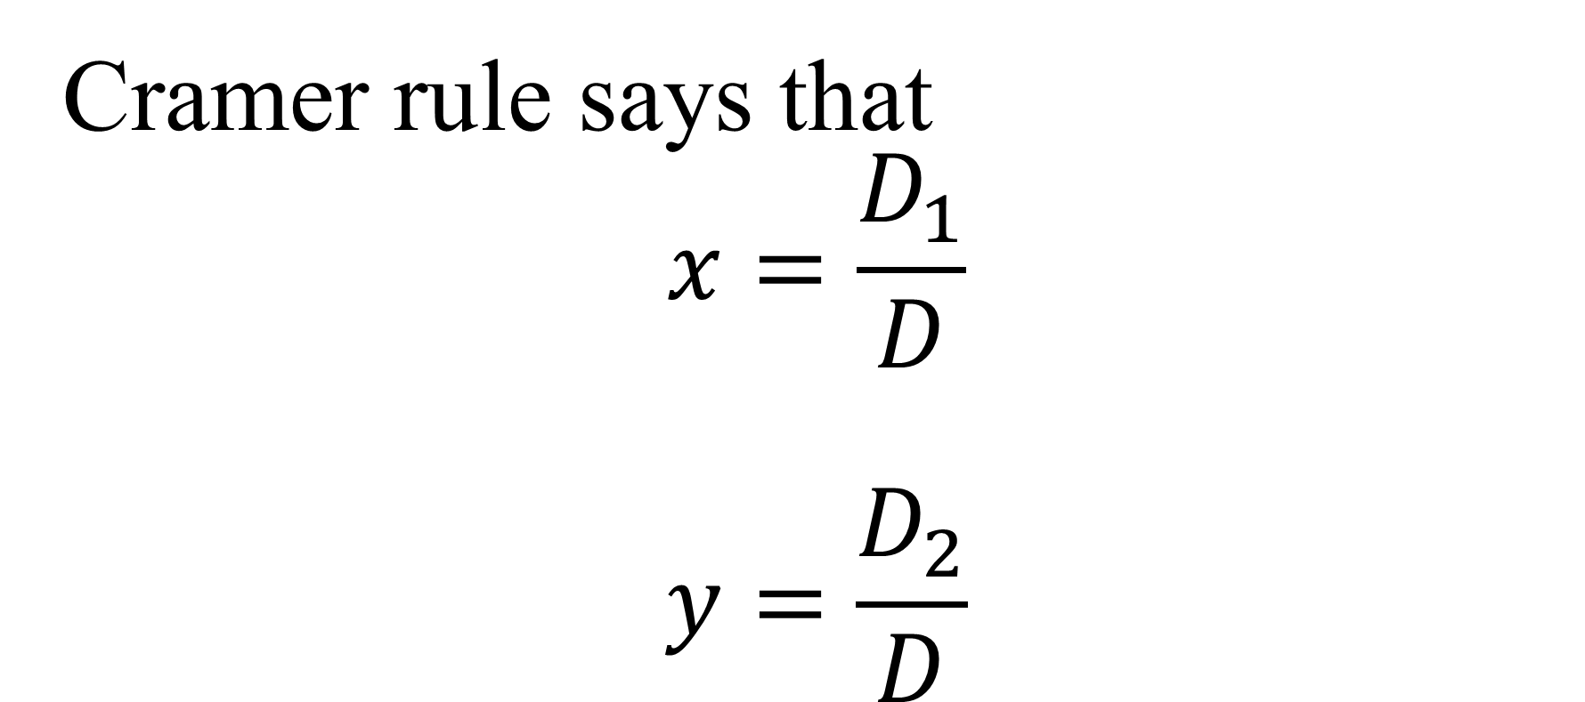
Cramer rule says that
$$x=\frac{D_{1}}{D}$$
$$y=\frac{D_{2}}{D}$$

Slide 31

$D=det\left[\begin{matrix}a & b \\ d & e\end{matrix}\right]$= ae - bd

Slide 32
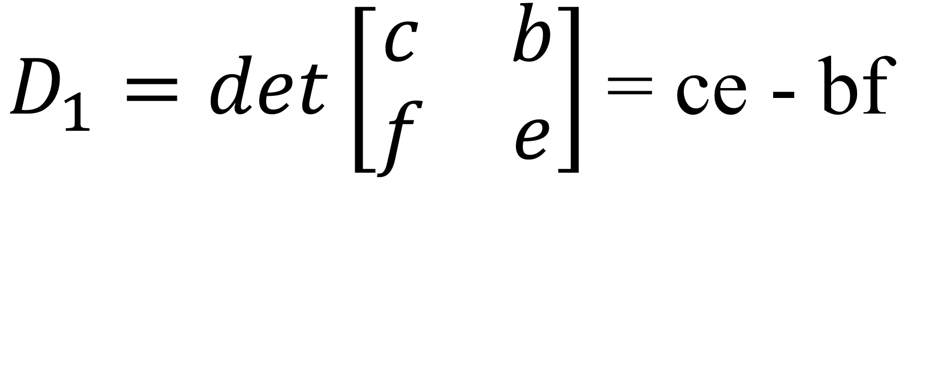
$D_{1}=det\left[\begin{matrix}c & b \\ f & e\end{matrix}\right]$= ce - bf

Slide 33

$D_{2}=det\left[\begin{matrix}a & c \\ d & f\end{matrix}\right]$= af - cd

Slide 34
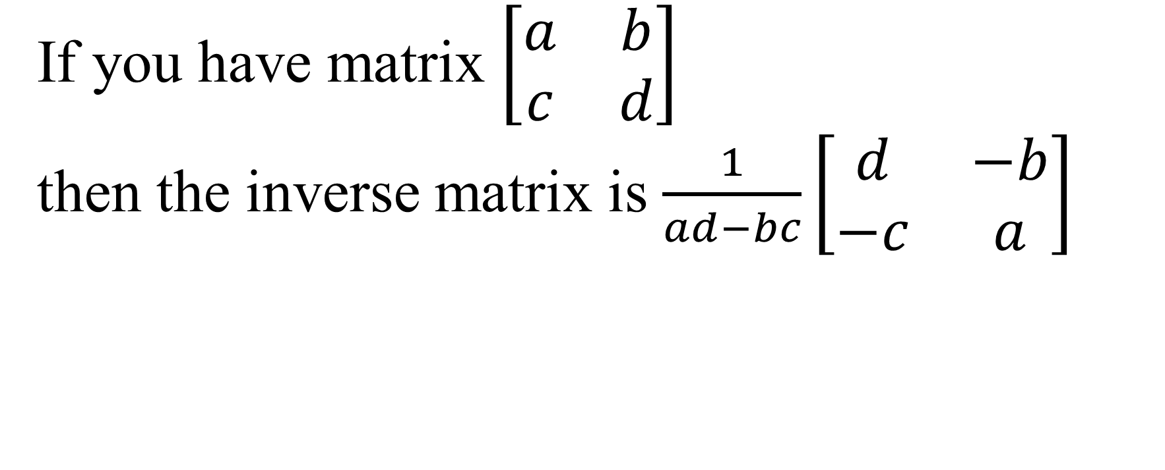
Finding inverse matrix
If you have matrix $\left[\begin{matrix}a & b \\ c & d\end{matrix}\right]$
then the inverse matrix is $\frac{1}{ad−bc}\left[\begin{matrix}d & −b \\ −c & a\end{matrix}\right]$

Slide 35
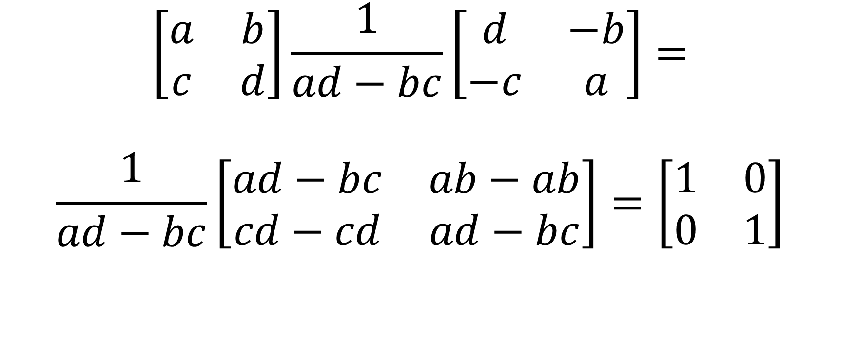
$$\left[\begin{matrix}a & b \\ c & d\end{matrix}\right]\frac{1}{ad−bc}\left[\begin{matrix}d & −b \\ −c & a\end{matrix}\right]=$$
$$\frac{1}{ad−bc}\left[\begin{matrix}ad−bc & ab−ab \\ cd−cd & ad−bc\end{matrix}\right]=\left[\begin{matrix}1 & 0 \\ 0 & 1\end{matrix}\right]$$

Slide 36
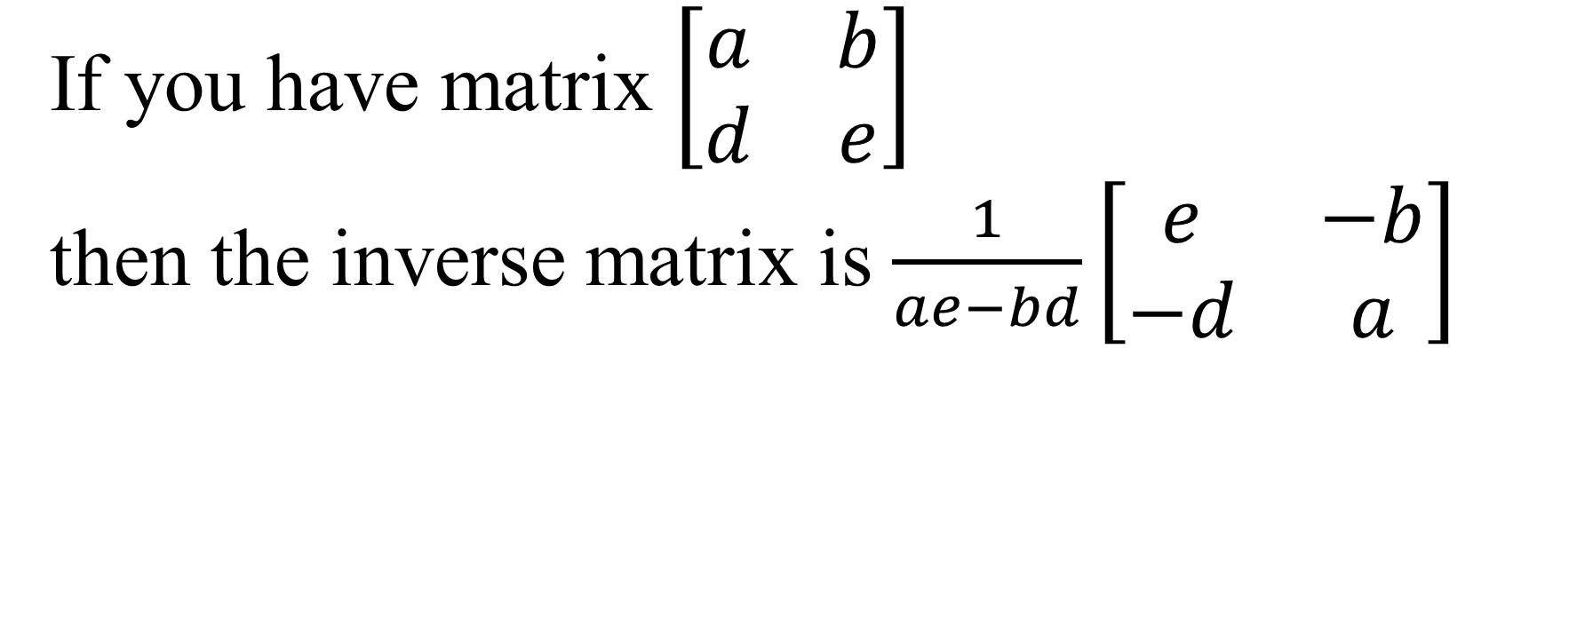
If you have matrix $\left[\begin{matrix}a & b \\ d & e\end{matrix}\right]$
then the inverse matrix is $\frac{1}{ae−bd}\left[\begin{matrix}e & −b \\ −d & a\end{matrix}\right]$

Slide 37
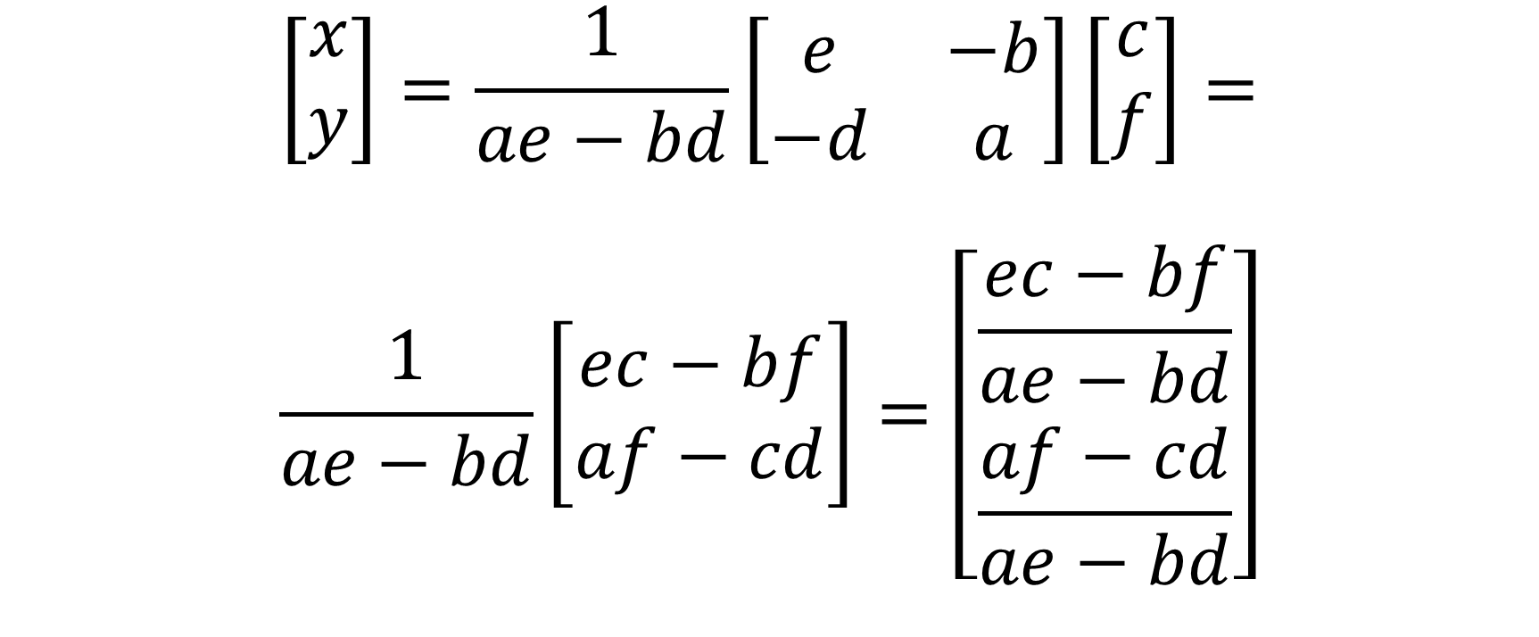
$$\left[\begin{matrix}x \\ y\end{matrix}\right]=\frac{1}{ae−bd}\left[\begin{matrix}e & −b \\ −d & a\end{matrix}\right]\left[\begin{matrix}c \\ f\end{matrix}\right]=$$
$$\frac{1}{ae−bd}\left[\begin{matrix}ec−bf \\ af−cd\end{matrix}\right]=\left[\begin{matrix}\frac{ec−bf}{ae−bd} \\ \frac{af−cd}{ae−bd}\end{matrix}\right]$$

Slide 38
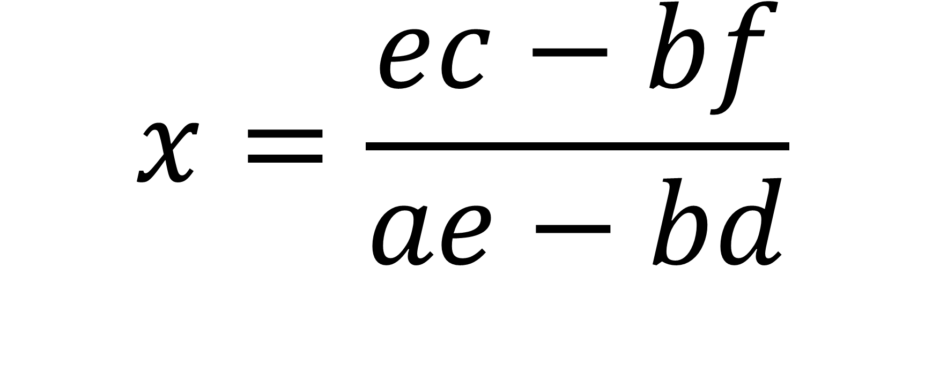
$$x=\frac{ec−bf}{ae−bd}$$

Slide 39
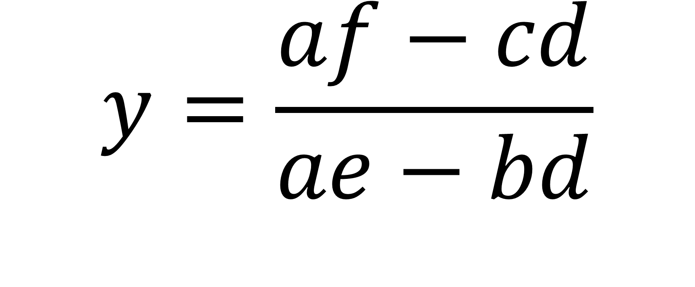
$$y=\frac{af−cd}{ae−bd}$$

Slide 40
This is the same as given by Cramer Rule

Slide 41
Product of matrix and its inverse matrix gives multiplicative identity matrix $\left[\begin{matrix}1 & 0 \\ 0 & 1\end{matrix}\right]$

Slide 42
If you have inverse matrix, then you can multiply left and right sides of your simultaneous equations by inverse matrix and get the answer.

Slide 43
Torque
Torque t is expressed through moments of inertia I and angular acceleration a.

Slide 44
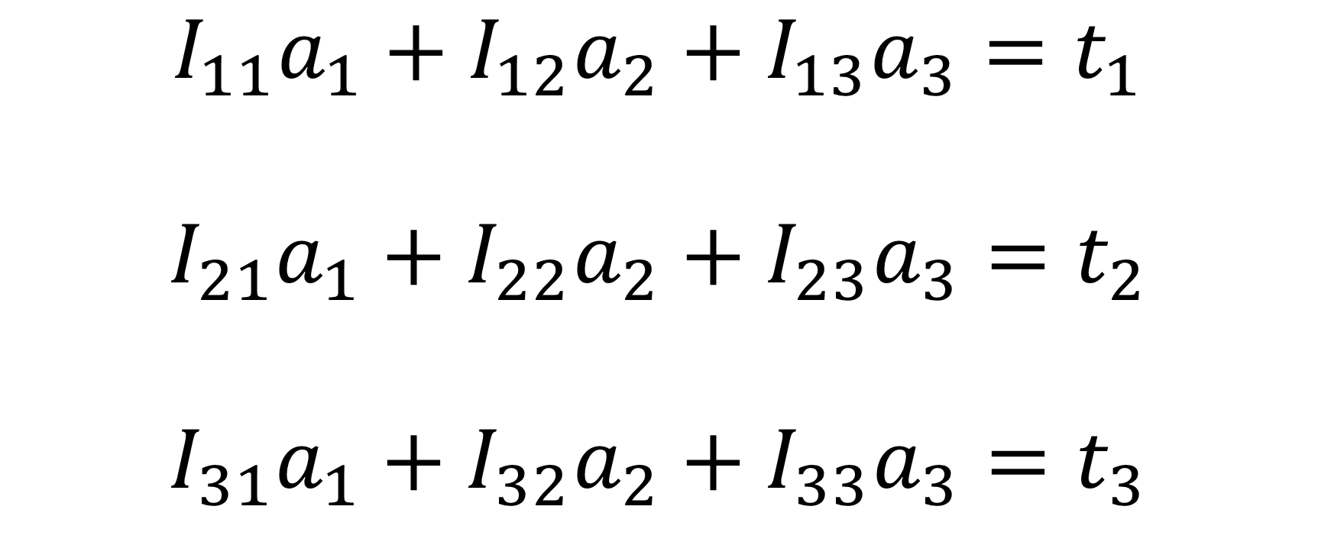
$$I_{11}a_{1}+I_{12}a_{2}+I_{13}a_{3}=t_{1}$$
$$I_{21}a_{1}+I_{22}a_{2}+I_{23}a_{3}=t_{2}$$
$$I_{31}a_{1}+I_{32}a_{2}+I_{33}a_{3}=t_{3}$$

Slide 45
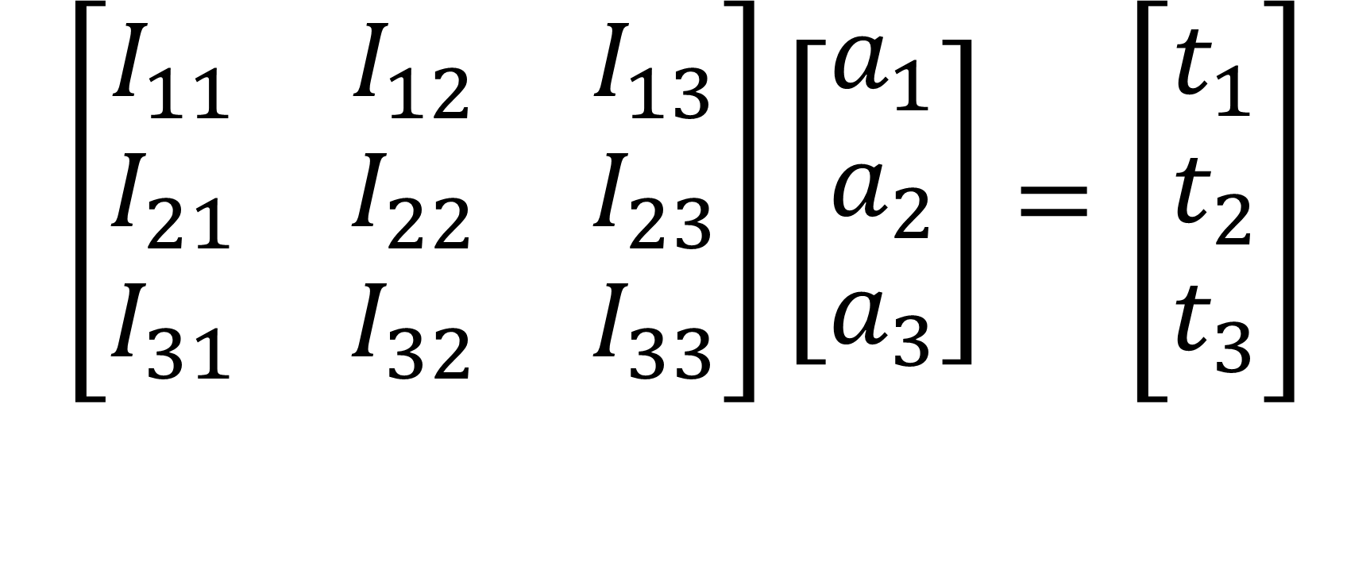
$$\left[\begin{matrix}I_{11} & I_{12} & I_{13} \\ I_{21} & I_{22} & I_{23} \\ I_{31} & I_{32} & I_{33}\end{matrix}\right]\left[\begin{matrix}a_{1} \\ a_{2} \\ a_{3}\end{matrix}\right]=\left[\begin{matrix}t_{1} \\ t_{2} \\ t_{3}\end{matrix}\right]$$

Slide 46

$$\sum_{c=1}^{3}{I_{mc}a_{c}=t_{m}}$$
m = 1, 2, 3.

Slide 47
We use Cramer Rule
en.wikipedia.org/wiki/Cramer%27s_rule

Slide 48
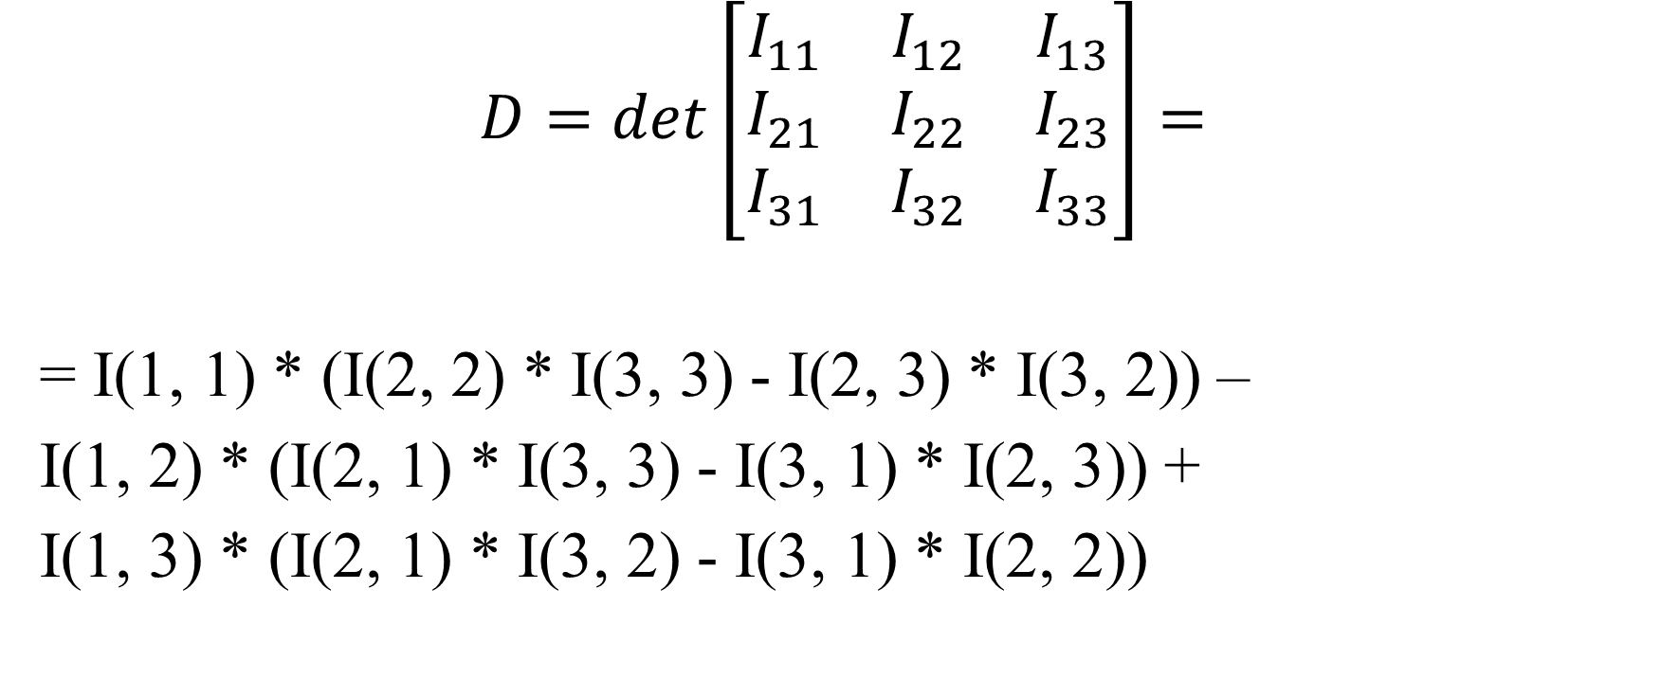
$$D=det\left[\begin{matrix}I_{11} & I_{12} & I_{13} \\ I_{21} & I_{22} & I_{23} \\ I_{31} & I_{32} & I_{33}\end{matrix}\right]=$$
= I(1, 1) * (I(2, 2) * I(3, 3) - I(2, 3) * I(3, 2)) –
I(1, 2) * (I(2, 1) * I(3, 3) - I(3, 1) * I(2, 3)) +
I(1, 3) * (I(2, 1) * I(3, 2) - I(3, 1) * I(2, 2))

Slide 49
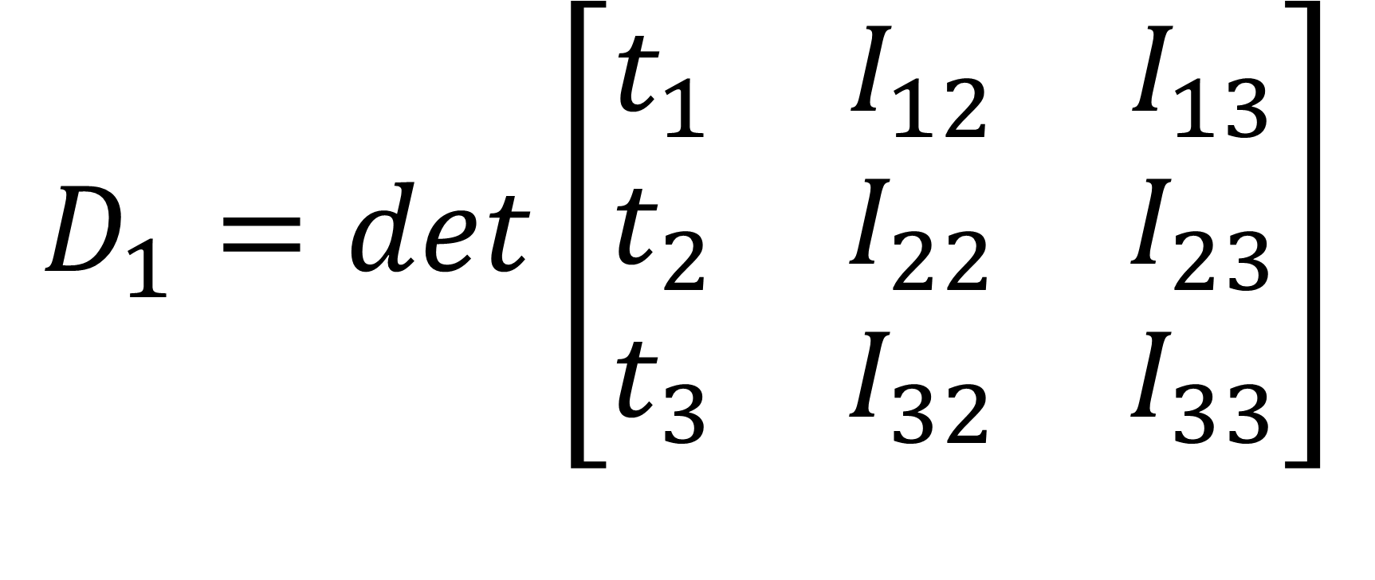
$$D_{1}=det\left[\begin{matrix}t_{1} & I_{12} & I_{13} \\ t_{2} & I_{22} & I_{23} \\ t_{3} & I_{32} & I_{33}\end{matrix}\right]$$

Slide 50
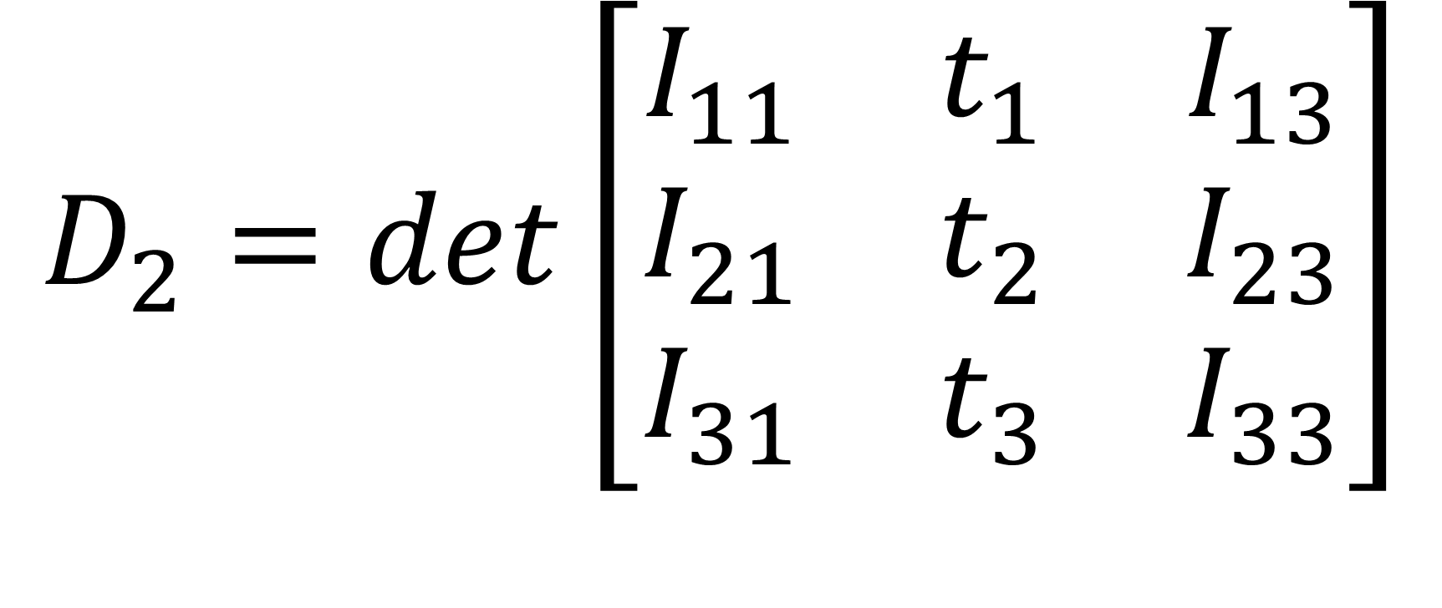
$$D_{2}=det\left[\begin{matrix}I_{11} & t_{1} & I_{13} \\ I_{21} & t_{2} & I_{23} \\ I_{31} & t_{3} & I_{33}\end{matrix}\right]$$

Slide 51
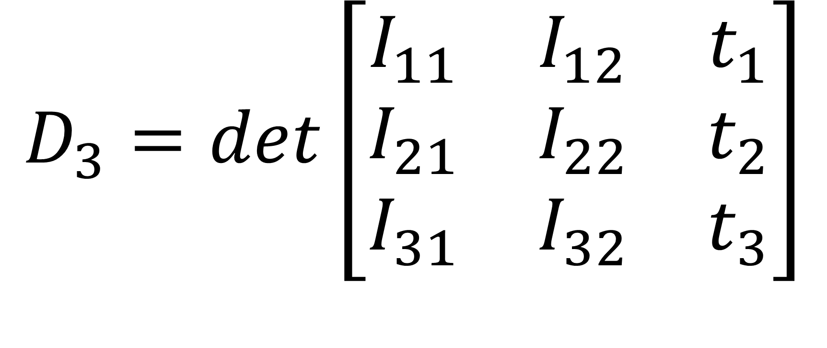
$$D_{3}=det\left[\begin{matrix}I_{11} & I_{12} & t_{1} \\ I_{21} & I_{22} & t_{2} \\ I_{31} & I_{32} & t_{3}\end{matrix}\right]$$

Slide 52

$$a_{1}=\frac{D_{1}}{D}$$

Slide 53

$$a_{2}=\frac{D_{2}}{D}$$

Slide 54

$$a_{3}=\frac{D_{3}}{D}$$

Slide 55
D must not be zero

Slide 56
Question:
Calculate angular acceleration for given tensor of inertia and torque.

Slide 57
I11 = s mod 11
I12 = s mod 12
I13 = s mod 13
I21 = s mod 21
I22 = s mod 22
I23 = s mod 23
I31 = s mod 31
I32 = s mod 32
I33 = s mod 33

Slide 58
t1 = s mod 10
t2 = s mod 20
t3 = s mod 30
torque(1) = s Mod 10
torque(2) = s Mod 20
torque(3) = s Mod 30

Slide 59
Dim a(3), I(3, 3), torque(3)
s = 99107088
torque(1) = s Mod 10
torque(2) = s Mod 20
torque(3) = s Mod 30

Slide 60
I(1, 1) = s Mod 11
I(1, 2) = s Mod 12
I(1, 3) = s Mod 13
I(2, 1) = s Mod 21
I(2, 2) = s Mod 22
I(2, 3) = s Mod 23
I(3, 1) = s Mod 31
I(3, 2) = s Mod 32
I(3, 3) = s Mod 33

Slide 61
determinant = I(1, 1) * (I(2, 2) * I(3, 3) - I(2, 3) * I(3, 2)) - I(1, 2) * (I(2, 1) * I(3, 3) - I(3, 1) * I(2, 3)) + I(1, 3) * (I(2, 1) * I(3, 2) - I(3, 1) * I(2, 2))

Slide 62
If determinant = 0 Then GoTo 1
'MsgBox determinant

Slide 63
I(1, 1) = torque(1)
I(2, 1) = torque(2)
I(3, 1) = torque(3)
determinant1 = I(1, 1) * (I(2, 2) * I(3, 3) - I(2, 3) * I(3, 2)) - I(1, 2) * (I(2, 1) * I(3, 3) - I(3, 1) * I(2, 3)) + I(1, 3) * (I(2, 1) * I(3, 2) - I(3, 1) * I(2, 2))
a(1) = determinant1 / determinant
MsgBox a(1)

Slide 64
I(1, 1) = s Mod 11
I(2, 1) = s Mod 21
I(3, 1) = s Mod 31
I(1, 2) = torque(1)
I(2, 2) = torque(2)
I(3, 2) = torque(3)

Slide 65
determinant2 = I(1, 1) * (I(2, 2) * I(3, 3) - I(2, 3) * I(3, 2)) - I(1, 2) * (I(2, 1) * I(3, 3) - I(3, 1) * I(2, 3)) + I(1, 3) * (I(2, 1) * I(3, 2) - I(3, 1) * I(2, 2))
a(2) = determinant2 / determinant
MsgBox a(2)

Slide 66
I(1, 2) = s Mod 12
I(2, 2) = s Mod 22
I(3, 2) = s Mod 32
I(1, 3) = torque(1)
I(2, 3) = torque(2)
I(3, 3) = torque(3)

Slide 67
determinant3 = I(1, 1) * (I(2, 2) * I(3, 3) - I(2, 3) * I(3, 2)) - I(1, 2) * (I(2, 1) * I(3, 3) - I(3, 1) * I(2, 3)) + I(1, 3) * (I(2, 1) * I(3, 2) - I(3, 1) * I(2, 2))
a(3) = determinant3 / determinant
MsgBox a(3)

Slide 68
I(1, 3) = s Mod 13
I(2, 3) = s Mod 23
I(3, 3) = s Mod 33

Slide 69
' Checking correctness of the solution:
For c = 1 To 3
'MsgBox torque(c)
Next c

Slide 70
For c = 1 To 3
torque(c) = 0
For cc = 1 To 3
torque(c) = torque(c) + I(c, cc) * a(cc)
Next cc
'MsgBox torque(c)
Next c

Slide 71
GoTo 2
1 determiniantIsZero = 0
MsgBox "Determinant = 0, no solutions"
2 ThereAreSolusions = 2

Slide 72
Checking for 2
Dim a(2), I(2, 2), torque(2)
s = 99107088
torque(1) = s Mod 10
torque(2) = s Mod 20

Slide 73
I(1, 1) = s Mod 11
I(1, 2) = s Mod 12
I(2, 1) = s Mod 21
I(2, 2) = s Mod 22

Slide 74
determinant = I(1, 1) * I(2, 2) - I(1, 2) * I(2, 1)
If determinant = 0 Then GoTo 1
'MsgBox determinant

Slide 75
I(1, 1) = torque(1)
I(2, 1) = torque(2)
determinant1 = I(1, 1) * I(2, 2) - I(1, 2) * I(2, 1)
a(1) = determinant1 / determinant
'MsgBox a(1)

Slide 76
I(1, 1) = s Mod 11
I(2, 1) = s Mod 21
I(1, 2) = torque(1)
I(2, 2) = torque(2)

Slide 77
determinant2 = I(1, 1) * I(2, 2) - I(1, 2) * I(2, 1)
a(2) = determinant2 / determinant
'MsgBox a(2)

Slide 78
I(1, 2) = s Mod 12
I(2, 2) = s Mod 22

Slide 79
' Checking correctness of the solution:
For c = 1 To 2
MsgBox torque(c)
Next c

Slide 80
For c = 1 To 2
torque(c) = 0
For cc = 1 To 2
torque(c) = torque(c) + I(c, cc) * a(cc)
Next cc
MsgBox torque(c)
Next c

Slide 81
GoTo 2
1 determiniantIsZero = 0
MsgBox "Determinant = 0, no solutions"
2 ThereAreSolusions = 2

Slide 82
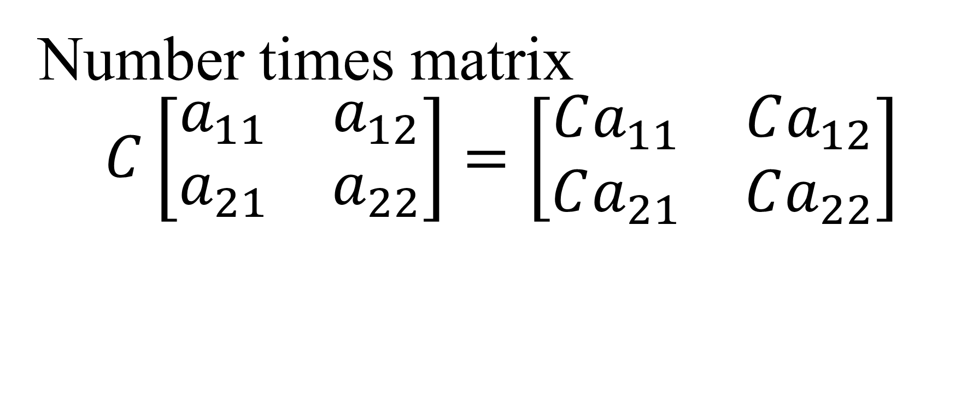
Matrix algebra
Number times matrix
$$C\left[\begin{matrix}a_{11} & a_{12} \\ a_{21} & a_{22}\end{matrix}\right]=\left[\begin{matrix}Ca_{11} & Ca_{12} \\ Ca_{21} & Ca_{22}\end{matrix}\right]$$

Slide 83

Sum of matrices
$$\left[\begin{matrix}a_{11} & a_{12} \\ a_{21} & a_{22}\end{matrix}\right]+\left[\begin{matrix}b_{11} & b_{12} \\ b_{21} & b_{22}\end{matrix}\right]=$$
$$\left[\begin{matrix}a_{11}+b_{11} & a_{12}+b_{12} \\ a_{21}+b_{21} & a_{22}+b_{22}\end{matrix}\right]=a_{ij}+b_{ij}$$
i,j = 1,2.

Slide 84

Minus is similar to plus for matrices.
$$\left[\begin{matrix}a_{11} & a_{12} \\ a_{21} & a_{22}\end{matrix}\right]−\left[\begin{matrix}b_{11} & b_{12} \\ b_{21} & b_{22}\end{matrix}\right]=\left[\begin{matrix}a_{11}−b_{11} & a_{12}−b_{12} \\ a_{21}−b_{21} & a_{22}−b_{22}\end{matrix}\right]=a_{ij}−b_{ij}$$
i,j = 1,2.

Slide 85
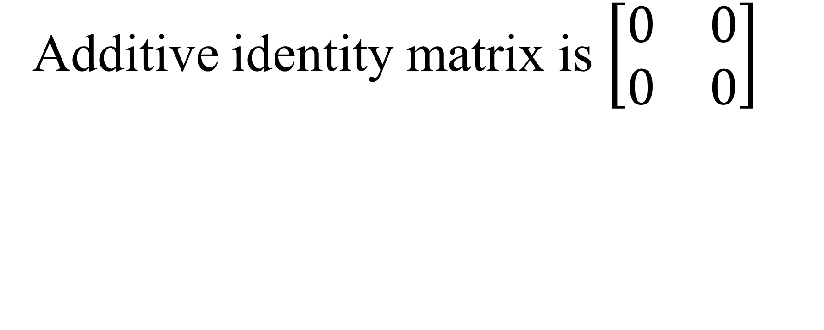
Additive identity matrix is $\left[\begin{matrix}0 & 0 \\ 0 & 0\end{matrix}\right]$

Slide 86

Multiplicative identity matrix is $\left[\begin{matrix}1 & 0 \\ 0 & 1\end{matrix}\right]$

Slide 87
To multiply matrices A and B matrix A must have the same number of columns and B rows.

Slide 88
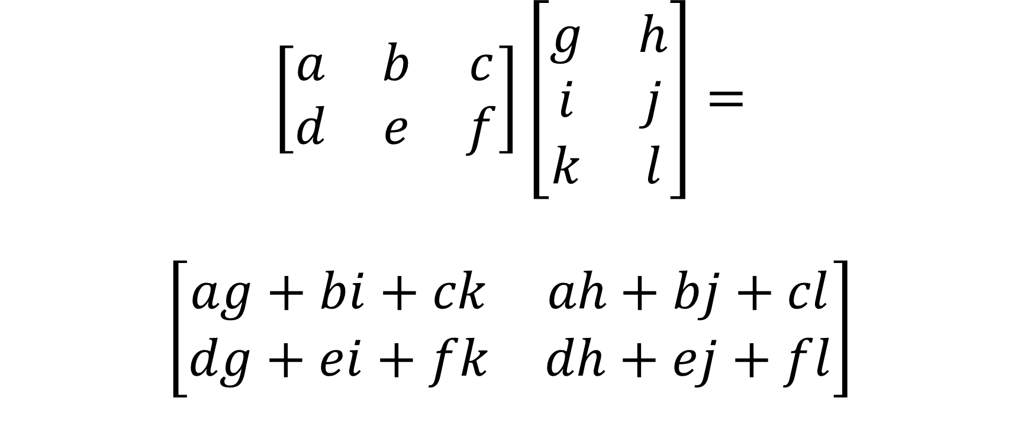
$$\left[\begin{matrix}a & b & c \\ d & e & f\end{matrix}\right]\left[\begin{matrix}g & h \\ i & j \\ k & l\end{matrix}\right]=$$
$$\left[\begin{matrix}ag+bi+ck & ah+bj+cl \\ dg+ei+fk & dh+ej+fl\end{matrix}\right]$$

Slide 89
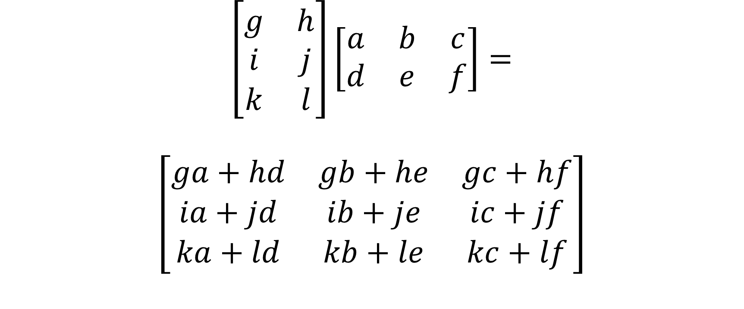
$$\left[\begin{matrix}g & h \\ i & j \\ k & l\end{matrix}\right]\left[\begin{matrix}a & b & c \\ d & e & f\end{matrix}\right]=$$
$$\left[\begin{matrix}ga+hd & gb+he & gc+hf \\ ia+jd & ib+je & ic+jf \\ ka+ld & kb+le & kc+lf\end{matrix}\right]$$

Slide 90
Relation
Relation links sets

Slide 91
Question:
Binary relation R on the set {1 to e+2} is defined so that aRb holds if and only if
a divides b, with NO remainder. Find the matrix and draw the graph.
Is it reflexive, symmetric, anti-symmetric, transitive, composite?

Slide 92
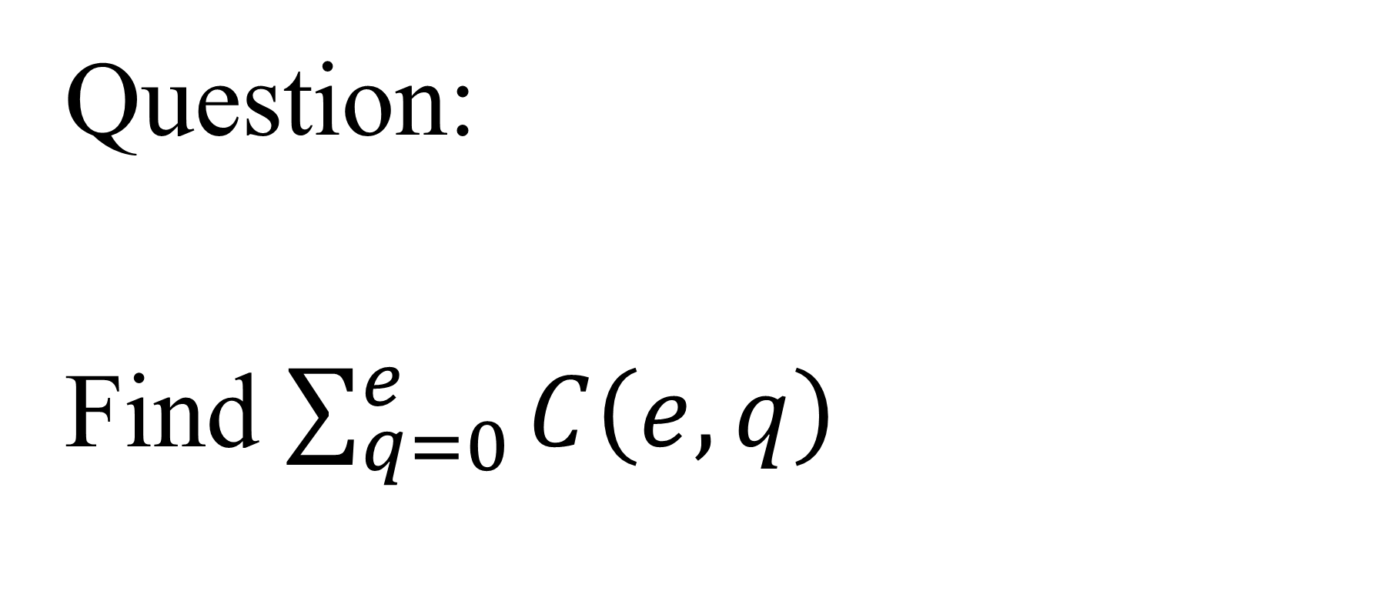
Question:
Find $\sum_{q=0}^{e}{C\left(e,q\right)}$

Slide 93
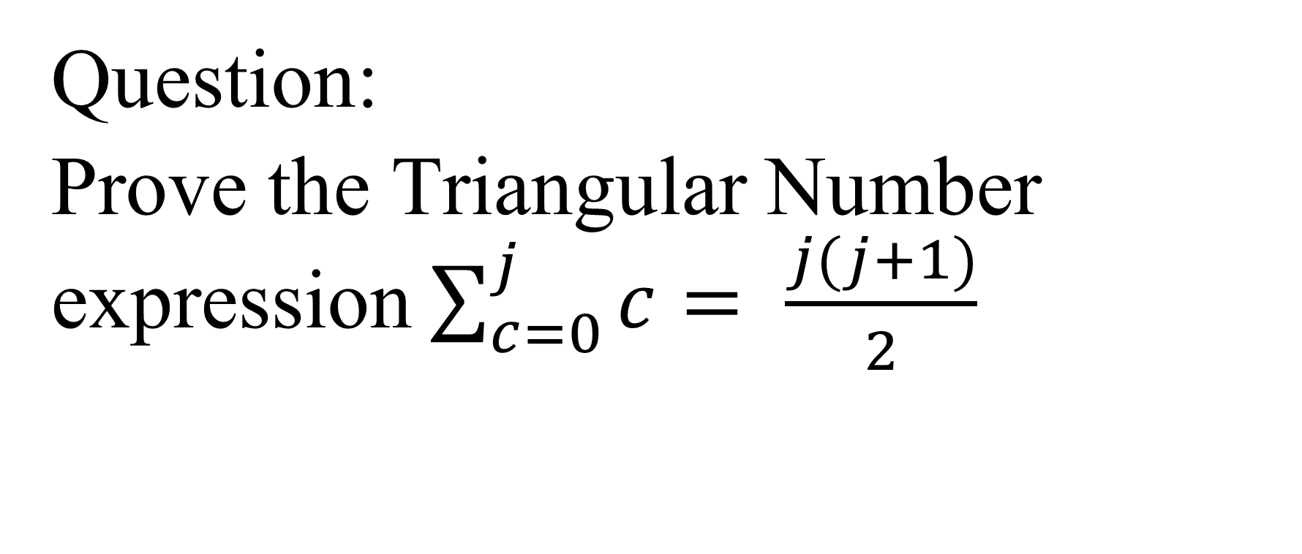
Question:
Prove the Triangular Number expression $\sum_{c=0}^{j}{c= \frac{j(j+1)}{2}}$

Slide 94
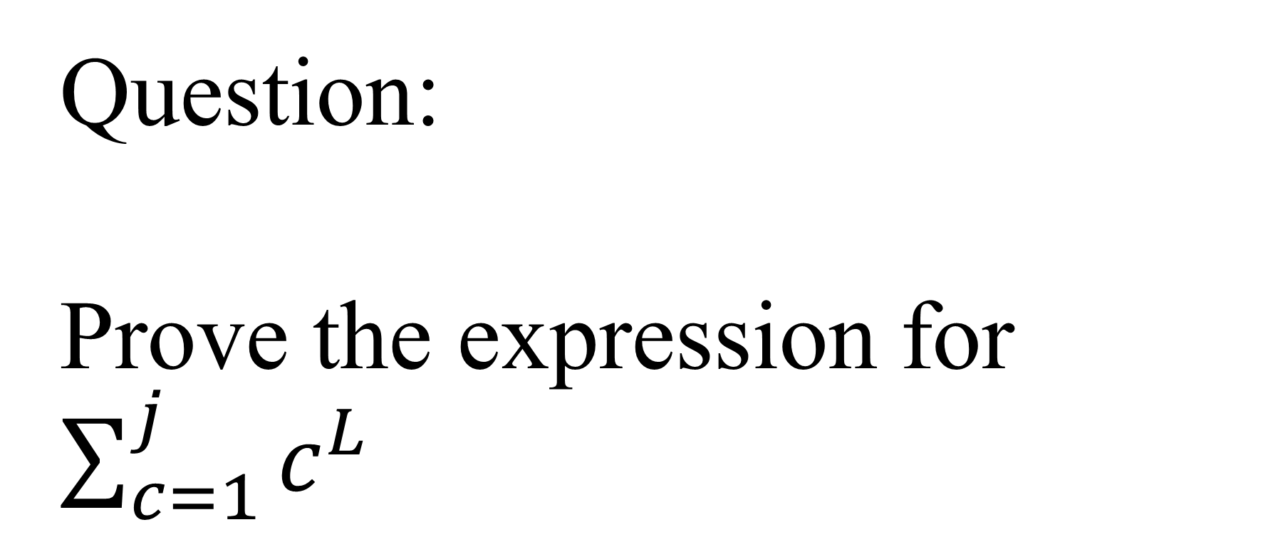
Question:
Prove the expression for $\sum_{c=1}^{j}{c^{L}}$

Slide 95
https://calculus12s.weebly.com/uploads/2/5/3/9/25393482/p2integration2vs2summation.docx

Slide 96
Number theory
Question:
Find Highest Common Divisor and Lowest Common Multiple of e+4 and L+4.

Slide 97
Question:
Convert T to e+2 and L+2 counting systems.

Slide 98
n = 100
b = 7

Slide 99
d1 = n Mod b ^ 1
MsgBox d1

Slide 100
d2 = (n Mod b ^ 2 - d1) / b ^ 1
MsgBox d2

Slide 101
d3 = (n Mod b ^ 3 - b ^ 1 * d2 - d1) / b ^ 2
MsgBox d3

Slide 102
d4 = (n Mod b ^ 4 - b ^ 2 * d3 - b ^ 1 * d2 - d1) / b ^ 3
MsgBox d4

Slide 103
d5 = (n Mod b ^ 5 - b ^ 3 * d4 - b ^ 2 * d3 - b ^ 1 * d2 - d1) / b ^ 4
MsgBox d5

Slide 104
d6 = (n Mod b ^ 6 - b ^ 4 * d5 - b ^ 3 * d4 - b ^ 2 * d3 - b ^ 1 * d2 - d1) / b ^ 5
MsgBox d6

Slide 105
d7 = (n Mod b ^ 7 - b ^ 5 * d6 - b ^ 4 * d5 - b ^ 3 * d4 - b ^ 2 * d3 - b ^ 1 * d2 - d1) / b ^ 6
MsgBox d7

Slide 106
'd8 = (n Mod b ^ 8 - b ^ 6 * d7 - b ^ 5 * d6 - b ^ 4 * d5 - b ^ 3 * d4 - b ^ 2 * d3 - b ^ 1 * d2 - d1) / b ^ 7
'MsgBox d8

Slide 107
d9 = (n Mod b ^ 9 - b ^ 7 * d8 - b ^ 6 * d7 - b ^ 5 * d6 - b ^ 4 * d5 - b ^ 3 * d4 - b ^ 2 * d3 - b ^ 1 * d2 - d1) / b ^ 8
MsgBox d9

Slide 108
'd10 = (n Mod b ^ 10 - b ^ 8 * d9 - b ^ 7 * d8 - b ^ 6 * d7 - b ^ 5 * d6 - b ^ 4 * d5 - b ^ 3 * d4 - b ^ 2 * d3 - b ^ 1 * d2 - d1) / b ^ 9
'MsgBox d10

Slide 109
Question:
Calculate the largest prime number you can using your own computer code.

Slide 110
n = 13
For i = 2 To Int(Sqr(n))
If n Mod i = 0 Then GoTo 1
Next i
MsgBox "prime"
GoTo 2
1 MsgBox "not prime"
2 Label2 = 2

Slide 111
Question:
Give prime factorization of s.

Slide 112
Dim p(9999), pf(9999)
mn = 2
nm = 9999

Slide 113
sn = 99107088
'
For i = 2 To Int(Sqr(sn))
If sn Mod i = 0 Then GoTo 11
Next i
MsgBox sn: MsgBox "is a prime number"
'Print #ii, sn, "is a prime number"
GoTo 333
11 abcdef = 1111

Slide 114
'nm = Int(Sqr(sn))
k = 0
For n = mn To nm
srn = Sqr(n)
isrn = Int(srn)
For i = 2 To isrn
If n Mod i = 0 Or srn = isrn Then GoTo 1
Next i
k = k + 1
p(k) = n
1 Next n

Slide 115
'MsgBox k
'
For i = 1 To k
'Print #ii, p(i)
Next i
For i = 1 To k
pf(i) = 0
Next i

Slide 116
srn = Sqr(sn)
isrn = Int(srn)
csn = sn
For i = 1 To k
Do While csn Mod p(i) = 0
csn = csn / p(i)
pf(i) = pf(i) + 1
Loop
111 Next i

Slide 117
For iiii = 2 To Int(Sqr(csn))
If csn Mod i = 0 Then GoTo 1111
Next iiii
ptc = 1
For i = 1 To k
'If pf(i) <> 0 Then ptc = ptc * p(i) ^ pf(i): Print #ii, i, pf(i), p(i)
If pf(i) <> 0 Then ptc = ptc * p(i) ^ pf(i)
'If pf(i) <> 0 Then Print #ii, p(i), "^", pf(i), "*"
If pf(i) <> 0 Then MsgBox p(i): MsgBox "^": MsgBox pf(i): MsgBox "*"
Next i

Slide 118
2 gfgfhgfdr = 5567
If ptc = 1 Then MsgBox sn: MsgBox "is a prime number": GoTo 333
ptc = ptc * csn
'Print #ii, csn, "^ 1"
MsgBox csn: MsgBox "^ 1"
GoTo 22
1111 abcd = 1

Slide 119
For i = 1 To k
'Print #ii, i, pf(i), p(i)
Next i
22 gfgfhgfdr = 5567
'Print #ii, sn, ptc
If sn = ptc Then MsgBox "corrrect"
If sn <> ptc Then MsgBox "wrong"
333 Label = 333

Slide 120
Question:
Calculate C(9,e) and P(7,e). Give all the options for C(e+3,e).

Slide 121
Question:
In how many ways can you answer an exam with m+1 questions
each of which has e+1 options for the answer?

Slide 122
Question:
Draw the histogram of tossing L+2 fair coins. Draw the histogram of the first e+3 digits of π.

Slide 123
Question:
Draw the histogram of adding random between e+2 times.

Slide 124
Question:
Give the histogram of Benford of the first digit of e+2 the most populated countries.
worldometers.info/world-population/population-by-country/

