Slide 1
14 Lecture in math
Revision
Absolute value
Inequalities
Limits
Functions
Modeling

Slide 2
Total scores for math and physics

Slide 3
If you want to improve your scores, do revision papers, another project about the final exam topics, etc.

Slide 4
Giving back homework

Slide 5
Giving back presentations scores

Slide 6
Malaysian math Professor

Slide 7
Revolution in math biology

Slide 8
Change your projects to the final exam topics, if necessary

Slide 9
My next homework will probably be due 7 January 2015 if the exams are around 13.1.2015

Slide 10
Revision papers:
Do only my revision papers after 27.12.2014
unless we have other assignments

Slide 11
Inequalities from the presentation

Slide 12
Limits from the presentation

Slide 13
Functions

Slide 14
Linear function

Slide 15
Parallel lines

Slide 16
Perpendicular lines

Slide 17
Sinusoidal function frequency, amplitude and phase

Slide 18
Main trigonometric identity:
sin²A + cos²A = 1

Slide 19
Exponential functions

Slide 20
Logarithmic functions:
Ln(e) = 1

Slide 21
Log base change

Slide 22
Graphing functions using derivatives, curvatures

Slide 23
Continuity

Slide 25
Math modeling

Slide 26
Math modeling (continued)
A mathematical model is a description of a system using mathematical concepts and language. The process of developing a mathematical model is termed mathematical modeling. Mathematical models are used not only in the natural sciences (such as physics, biology, earth science, meteorology) and engineering disciplines (e.g. computer science, artificial intelligence), but also in the social sciences (such as economics, psychology, sociology and political science); physicists, engineers, statisticians, operations research analysts and economists use mathematical models most extensively. A model may help to explain a system and to study the effects of different components, and to make predictions about behaviur.

Slide 27
Math modeling (continued)
Mathematical models can take many forms, including but not limited to dynamical systems, statistical models, differential equations, or game theoretic models. These and other types of models can overlap, with a given model involving a variety of abstract structures. In general, mathematical models may include logical models, as far as logic is taken as a part of mathematics. In many cases, the quality of a scientific field depends on how well the mathematical models developed on the theoretical side agree with results of repeatable experiments. Lack of agreement between theoretical mathematical models and experimental measurements often leads to important advances as better theories are developed.

Slide 28
Derivative

Slide 29
Integral

Slide 30
Tables of derivatives and integrals

Slide 31
Logistic function

Slide 32
Population growth
A typical application of the logistic equation is a common model of population growth, originally due to Pierre-François Verhulst in 1838, where the rate of reproduction is proportional to both the existing population and the amount of available resources, all else being equal. The Verhulst equation was published after Verhulst had read Thomas Malthus' An Essay on the Principle of Population.

Slide 33
Population growth (continued)
Verhulst derived his logistic equation to describe the self-limiting growth of a biological population. The equation is also sometimes called the Verhulst-Pearl equation following its rediscovery in 1920. Alfred J. Lotka derived the equation again in 1925, calling it the law of population growth.

Slide 34
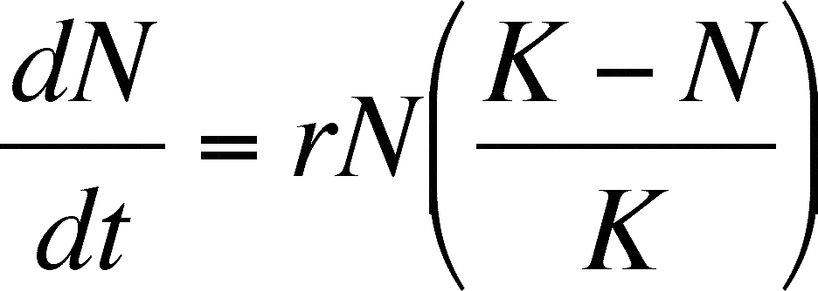

Slide 35
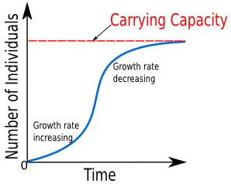

Slide 36
Logistic growth proofs

Slide 37
Eigenvalues

Slide 38
Complexity in biology

Slide 39
5 marks for English use

Slide 40
Tutorials:
Attend tutorials

Slide 41
Enjoy your studies; do not push yourself too hard, especially if the subject is not very relevant to your major
I enjoy watching good videos about math and looking through the math book, notes and presentations

Slide 42
Do not spend money for the exam
Do not print for the exam
Do not photocopy for the exam

Slide 43
Biomath

Slide 45
Visit my web sites

Slide 46
math = subject of the Emails to me

Slide 47
Textbook

Slide 48
Videos about math, etc.

