Slide 1
Introduction to math, number, function, logic, sets

Slide 2
Math is a method of science
Math is in food science, agribusiness, teleportation, quantum computers, almost everywhere.

Slide 3
Detailed explanation of math
biomath.weebly.com
statistics4students.weebly.com
discrete4math.weebly.com
discrete7math.weebly.com
calculus12s.weebly.com
calculus17.weebly.com
calculus1only.weebly.com
calculus2only.weebly.com
algebra4students.weebly.com

Slide 4
Question:
What is math?
Question:
What do you want from this math course?

Slide 5
Project
Try to do your project on any topic you like or interested in.
You may present your project to the audience.

Slide 6
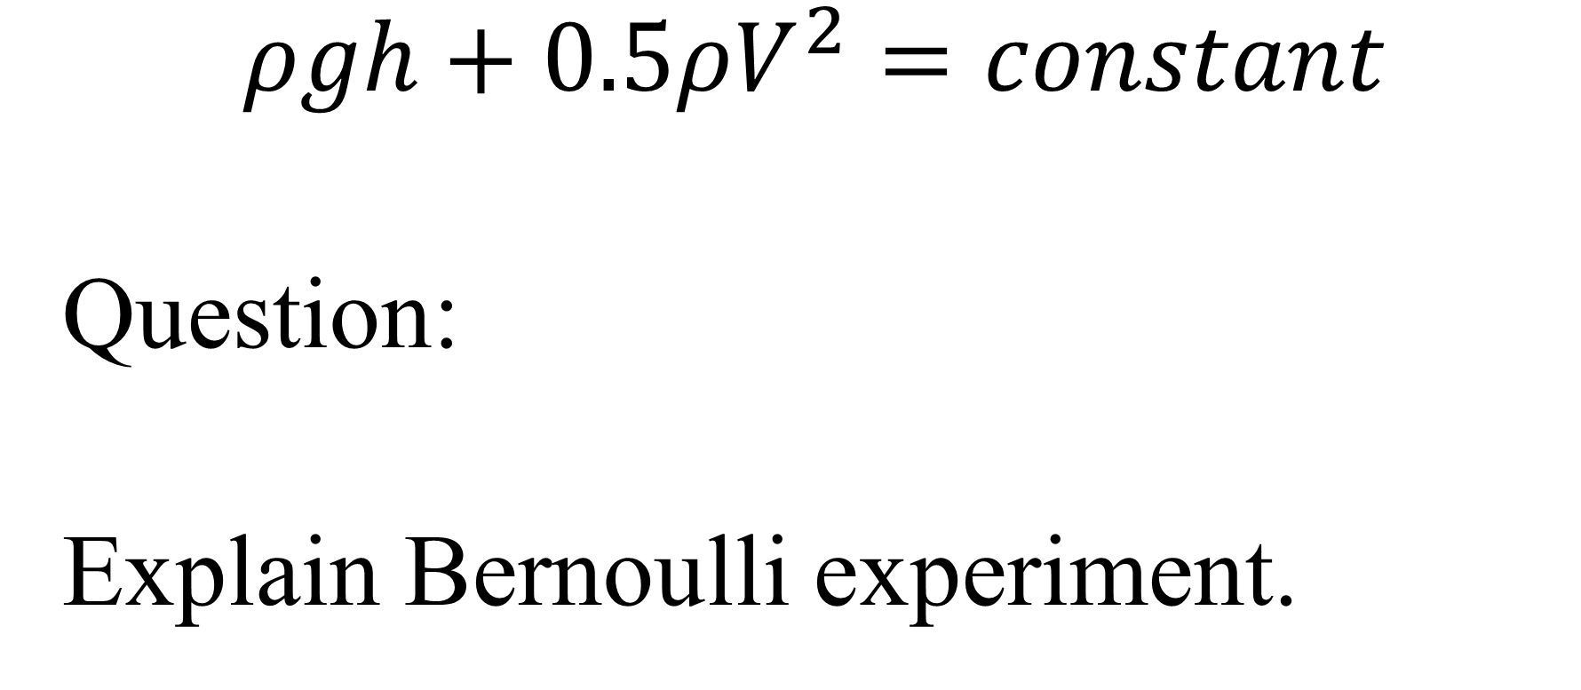
Bernoulli experiment
$$ρgh+0.5ρV^{2}=constant$$
Question:
Explain Bernoulli experiment.

Slide 7
Number theory
Natural, integer, rational, irrational, real, complex numbers.
Prime numbers are the building blocks of all the other numbers, just like chemical elements are the building blocks of all the substances.
Question:
Give examples of natural, integer, rational, irrational, real, complex numbers.

Slide 8
Number puzzle game
Question:
Solve number puzzle for 3 + m₄ digits.
m₄ = s mod 4
s is your student number
https://discrete4math.weebly.com/uploads/2/5/3/9/25393482/code1-4numberpuzzles.txt
https://discrete4math.weebly.com/uploads/2/5/3/9/25393482/code1-5numberpuzzles.txt
https://discrete4math.weebly.com/uploads/2/5/3/9/25393482/code1-6numberpuzzles.txt
https://discrete4math.weebly.com/uploads/2/5/3/9/25393482/code0-6numberpuzzles.txt
https://discrete4math.weebly.com/uploads/2/5/3/9/25393482/code1-8numberpuzzles.txt

Slide 9
E calculation
Question:
Find approximation of e number.
Calculate (1+1/T)^{T}.
s = 19107016
T = s Mod 100
MsgBox (1 + 1 / T) ^ T
https://calculus17.weebly.com/uploads/7/7/9/0/77906190/e_approximation2019oct.txt

Slide 10
Functions theory
Linear, exponential, logarithmic functions
Exponential growth and decay
There are elementary, algebraic, special functions.

Slide 11
Even and odd functions
Even function: f(x) = f(-x)
Odd function: f(x) = - f(-x)

Slide 12
Composite function
f(g(x))

Slide 13
Inverse function
f⁻¹(x), f⁻¹(f(x)) = f (f⁻¹(x)) = x

Slide 14
Inverse function (continued)
Here are examples of functions, for which inverse functions are the same:
y = x
y = 1 – x
y = 1/x

Slide 15
Functions (continued)
Question:
What are the main functions?
Question:
Find inverse functions, which are the same as the original functions.

Slide 16
Logic
Truth tables of NOT, AND, OR
Arithmetic equivalents
NOT A = A + (-1)^{A}
A AND B = AB
A OR B = A + B - AB

Slide 17
Logic (continued)
Question:
Give truth tables of NOT, AND, OR and their arithmetic equivalents.

Slide 18
Implication
If I study hard then I will be rich. Analyse this implication.

Slide 19
Boolean algebra
Writing formula of Boolean function based on its truth table.
Question:
Give expression of implication through NOT, AND, OR and their arithmetic equivalents.

Slide 20
Proof
Nothing can be proved perfectly; this is used a lot in real life.
There are different kinds of proof.

Slide 21

Proof (continued)
Question:
Prove by induction.
Prove $\sum_{i=0}^{T}{b^{i}=\frac{1−b^{T+1}}{1−b}}$.

Slide 22
Probability
Averages
Mean, median and mode
Binomial distribution

Slide 23
Sets
Set is a collection of some elements. Order does NOT matter.
Repetition of the same element counts as one element.
Since order does NOT matter, the total number of subsets of a set is sum of all the combinations, which means 2^{T}, where T is the number of elements (cardinality) of the set.
Question:
How many subsets are there in a set of T elements?

Slide 24
Limit
Question:
Illustrate definition of limit using ε – δ language.
$\underset{x→p}{Lim}{f\left(x\right) = L}$. f(x) = Tx + k. For any ε find δ, using ε – δ definition of the limit.

Slide 25
Limit (continued)
Question:
m2 = 0: When does limit exist?
https://brilliant.org/wiki/when-does-a-limit-exist/
https://en.wikipedia.org/wiki/Limit_of_a_function
m2 = 1: List indeterminate forms.
https://en.wikipedia.org/wiki/Indeterminate_form

Slide 26
Limit (continued)
Question:
Give L’Hopital rule.
https://en.wikipedia.org/wiki/L%27H%C3%B4pital%27s_rule#targetText=In%20mathematics%2C%20more%20specifically%20calculus,be%20easily%20evaluated%20by%20substitution.
m₄ = 0: Use L’Hopital rule to prove First Great Limit of Calculus: $\underset{x→0}{Lim}{\frac{sin⁡(x)}{x}=}$
m₄ = 1: $\underset{x→0}{Lim}{\frac{x}{x}=}$
m₄ = 2: $\underset{x→1}{Lim}{\frac{x^{2}−3x+2}{x−1}=}$
m₄ = 3: $\underset{x→2}{Lim}{\frac{x^{2}−3x+2}{x−2}}=$

Slide 27
Continuity
Question:
Investigate continuity of the function:
m₇ = 0: x
m₇ = 1: $\left\lceil x\right\rceil$
m₇ = 2: $\frac{1}{x}$
m₇ = 3: $\frac{1}{x^{2}}$
m₇ = 4: $\frac{x}{x}$
m₇ = 5: $\frac{x^{2}−3x+2}{x−1}$
m₇ = 6: $\frac{x^{2}−3x+2}{x−2}$

Slide 28
Derivative
Question:
What is derivative?
Question:
m2 = 1: Give the properties of derivative: times constant, sum, product, quotient.
Question:
m₂ = 0: Prove expression for derivative of x² using limit.

Slide 29
Derivative (continued)
Question:
Find derivatives of these functions:
m₄ = 0: e^{x}
m₄ = 1: x^{p}
m₄ = 2: cos(x)
m₄ = 3: ${\left(x^{n}\right)}^{\left(n\right)}$
https://www.derivative-calculator.net/

Slide 30
Derivative (continued)
Question:
Calculate derivative, using Chain Rule for sin(Tx)

Slide 31
Differential
Question:
m₄ = 0: d(f+g) =
m₄ = 1: d(f-g) =
m₄ = 2: d(fg) =
m₄ = 3: d(f/g) =

Slide 32
Application of derivative
Question:
Increasing or decreasing:
m5 = 0. -6x
m5 = 1. 9x
m5 = 2. sin(x)
m5 = 3. cos(x)
m5 = 4. tan(x)
https://www.derivative-calculator.net/

Slide 33
Application of derivative (continued)
Question:
Find min and Max.
Find the largest area rectangle with perimeter of T meters.
Calculate the largest area right-angled triangle with perimeter of T meters.
Find maximum volume cylinder for surface area of T meters square.
Calculate maximum volume cone for surface area of T meters square.
Calculate maximum area scalene triangle with perimeter of T meters.

Slide 34
Application of derivative (continued)
Question:
Concave or convex:
m₄ = 0: x³
m₄ = 1: -x³
m₄ = 2: cos(x)
m₄ = 3: sin(x)

Slide 35
Application of derivative (continued)
Question:
Find inflection point:
m₄ = 0: x³
m₄ = 1: -x³
m₄ = 2: cos(x)
m₄ = 3: sin(x)

Slide 36
Linear regression
Question:
Find linear least-square approximation for your dataset.
(2, m₂), (3, m₃), (4, m₄)
https://calculus17.weebly.com/uploads/7/7/9/0/77906190/3points_group_task_25oct2018.txt

Slide 37
Diffusion
Substance S diffuses in time in one dimension x.
$\frac{∂S}{∂t}=D\frac{∂^{2}S}{∂x^{2}}$ (equation)
$S\left(∞,t\right)=0$ (boundary condition)
$S\left(x,t\right)=\frac{e^{−\frac{x^{2}}{4Dt}}}{\sqrt{4πDt}}$ (solution)

