Slide 1
2 Lecture in math
Logic of math
Proposition
Operand
connective
Truth Table
Tautology
Contradiction
Contingency
not, and, or (inclusive and exclusive)
gates
De Morgan's laws

Slide 2
Logic of math
Mathematical logic is a subfield of mathematics exploring the applications of formal logic to mathematics. Topically, mathematical logic bears close connections to metamathematics, the foundations of mathematics, and theoretical computer science. The unifying themes in mathematical logic include the study of the expressive power of formal systems and the deductive power of formal proof systems.
Mathematical logic is often divided into the fields of set theory, model theory, recursion theory, and proof theory. These areas share basic results on logic, particularly first-order logic, and definability. In computer science (particularly in the ACM Classification) mathematical logic encompasses additional topics not detailed in this article; see Logic in computer science for those.

Slide 3
2 Logic of math
Since its inception, mathematical logic has both contributed to, and has been motivated by, the study of foundations of mathematics. This study began in the late 19th century with the development of axiomatic frameworks for geometry, arithmetic, and analysis. In the early 20th century it was shaped by David Hilbert's program to prove the consistency of foundational theories. Results of Kurt Gödel, Gerhard Gentzen, and others provided partial resolution to the program, and clarified the issues involved in proving consistency. Work in set theory showed that almost all ordinary mathematics can be formalized in terms of sets, although there are some theorems that cannot be proven in common axiom systems for set theory. Contemporary work in the foundations of mathematics often focuses on establishing which parts of mathematics can be formalized in particular formal systems (as in reverse mathematics) rather than trying to find theories in which all of mathematics can be developed.

Slide 4
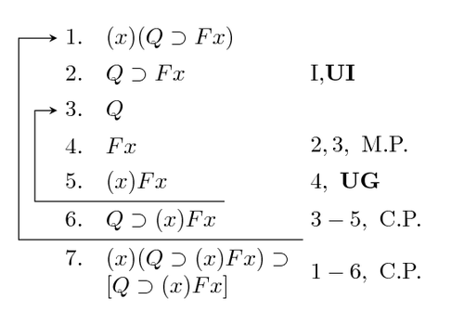
3 Logic of math

Slide 5
Truth
Logical truth is one of the most fundamental concepts in logic, and there are different theories on its nature. A logical truth is a statement which is true and remains true under all reinterpretations of its components other than its logical constants. It is a type of analytic statement. All of philosophical logic can be thought of as providing accounts of the nature of logical truth, as well as logical consequence.

Slide 6
2 Truth
Logical truths (including tautologies) are truths which are considered to be necessarily true. This is to say that they are considered to be such that they could not be untrue and no situation could arise which would cause us to reject a logical truth. However, it is not universally agreed that there are any statements which are necessarily true.

Slide 7
3 Truth
A logical truth is considered by some philosophers to be a statement which is true in all possible worlds. This is contrasted with facts (which may also be referred to as contingent claims or synthetic claims) which are true in this world, as it has historically unfolded, but which is not true in at least one possible world, as it might have unfolded. The proposition "If p and q, then p" and the proposition "All married people are married" are logical truths because they are true due to their inherent structure and not because of any facts of the world. Later, with the rise of formal logic a logical truth was considered to be a statement which is true under all possible interpretations.

Slide 8
4 Truth
The existence of logical truths has been put forward by rationalist philosophers as an objection to empiricism because they hold that it is impossible to account for our knowledge of logical truths on empiricist grounds. Empiricists commonly respond to this objection by arguing that logical truths (which they usually deem to be mere tautologies), are analytic and thus do not purport to describe the world.

Slide 9
Truth Table
A truth table is a two-dimensional array with columns. The first columns correspond to the possible values of inputs, and the last column to the operation being performed. The rows list all possible combinations of inputs together with the corresponding outputs. For example, the following truth table shows the result of the binary AND operator acting on two inputs and , each of which may be true or false.

Slide 10
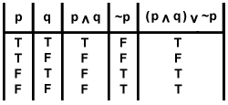
Truth Table

Slide 11
Operand
An operand is the object of a mathematical operation, a quantity on which an operation is performed.

Slide 12
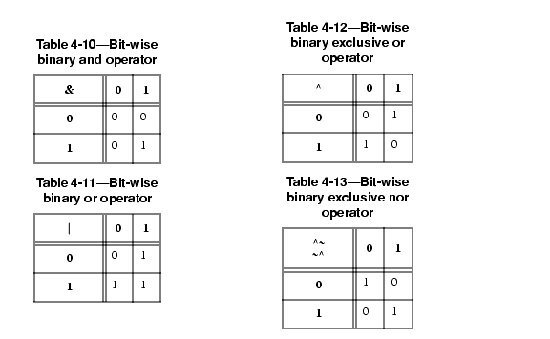
2 Operand

Slide 13
Logical connective
A logical connective (also called a logical operator) is a symbol or word used to connect two or more sentences (of either a formal or a natural language) in a grammatically valid way, such that the sense of the compound sentence produced depends only on the original sentences.
The most common logical connectives are binary connectives (also called dyadic connectives) which join two sentences which can be thought of as the function's operands. Also commonly, negation is considered to be a unary connective.
Logical connectives along with quantifiers are the two main types of logical constants used in formal systems such as propositional logic and predicate logic. Semantics of a logical connective is often, but not always, presented as a truth function.

Slide 14
2 Logical connective

Slide 15
Rule of inference
A rule of inference, inference rule, or transformation rule is a logical form consisting of a function which takes premises, analyzes their syntax, and returns a conclusion (or conclusions). For example, the rule of inference called modus ponens takes two premises, one in the form "If p then q" and another in the form "p", and returns the conclusion "q". The rule is valid with respect to the semantics of classical logic (as well as the semantics of many other non-classical logics), in the sense that if the premises are true (under an interpretation), then so is the conclusion.

Slide 16
2 Rule of inference
Typically, a rule of inference preserves truth, a semantic property. In many-valued logic, it preserves a general designation. But a rule of inference's action is purely syntactic, and does not need to preserve any semantic property: any function from sets of formulae to formulae counts as a rule of inference. Usually only rules that are recursive are important; i.e. rules such that there is an effective procedure for determining whether any given formula is the conclusion of a given set of formulae according to the rule. An example of a rule that is not effective in this sense is the infinitary ω-rule.^{[1]}
Popular rules of inference in propositional logic include modus ponens, modus tollens, and contraposition. First-order predicate logic uses rules of inference to deal with logical quantifiers.

Slide 17
3 Rule of inference

Slide 18
Negation
Negation, also called logical complement, is an operation that takes a proposition p to another proposition "not p", written ¬p, which is interpreted intuitively as being true when p is false and false when p is true. Negation is thus a unary (single-argument) logical connective. It may be applied as an operation on propositions, truth values, or semantic values more generally. In classical logic, negation is normally identified with the truth function that takes truth to falsity and vice versa. In intuitionistic logic, according to the Brouwer–Heyting–Kolmogorov interpretation, the negation of a proposition p is the proposition whose proofs are the refutations of p.

Slide 19
Conjunction
A two-place logical operator and, also known as logical conjunction, results in true if both of its operands are true, otherwise the value of false.
The analogue of conjunction for a (possibly infinite) family of statements is universal quantification, which is part of predicate logic.

Slide 20
Disjunction
Or is a truth-functional operator also known as (inclusive) disjunction and alternation. The logical connective that represents this operator is also known as "or“.

Slide 21
Exclusive or
Exclusive disjunction or exclusive or (/ˌɛks ˈɔr/) is a logical operation that outputs true whenever both inputs differ (one is true, the other is false).

Slide 22
Tautology
A tautology is a proposition, which is always true.

Slide 23
Tautology

Slide 24
Contradiction
A contradiction is a proposition which is always false.

Slide 25
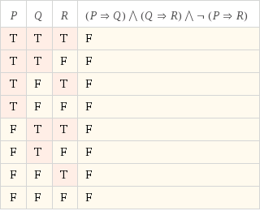
Contradiction

Slide 26
Contingency
A sentence is called a contingency if its truth table contains at least one 'T' and at least one 'F.'

Slide 27
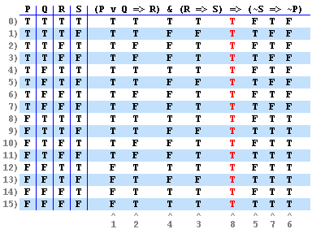
Contingency

Slide 28
Logical consequence
Logical consequence (also entailment) is one of the most fundamental concepts in logic. It is the relationship between statements that holds true when one logically "follows from" one or more others. A valid logical argument is one in which the conclusions follow from its premises, and its conclusions are consequences of its premises. The philosophical analysis of logical consequence involves asking, 'in what sense does a conclusion follow from its premises?' and 'what does it mean for a conclusion to be a consequence of premises?' All of philosophical logic can be thought of as providing accounts of the nature of logical consequence, as well as logical truth.
Logical consequence is taken to be both necessary and formal with examples explicated using models and proofs. A sentence is said to be a logical consequence of a set of sentences, for a given language, if and only if, using logic alone (i.e. without regard to any interpretations of the sentences) the sentence must be true if every sentence in the set were to be true.

Slide 29
Proposition
A proposition is a statement which can either be true or false.

Slide 30
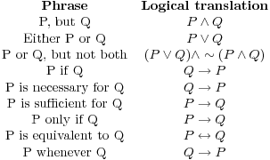
Proposition

Slide 31
Propositional logic
A propositional logic (also called sentential logic) is a formal system in which formulas of a formal language may be interpreted to represent propositions. A system of inference rules and axioms allows certain formulas to be derived. These derived formulas are called theorems and may be interpreted to be true propositions. Such a constructed sequence of formulas is known as a derivation or proof and the last formula of the sequence is the theorem. The derivation may be interpreted as proof of the proposition represented by the theorem.
Usually in Truth-functional propositional logic, formulas are interpreted as having either a truth value of true or a truth value of false. Truth-functional propositional logic and systems isomorphic to it, are considered to be zeroth-order logic.

Slide 32
Premise
A premise or premiss is a statement that an argument claims will induce or justify a conclusion. In other words: a premise is an assumption that something is true. In logic, an argument requires a set of (at least) two declarative sentences (or "propositions") known as the premises or premisses along with another declarative sentence (or "proposition") known as the conclusion. This structure of two premises and one conclusion forms the basic argumentative structure. More complex arguments can use a series of rules to connect several premises to one conclusion, or to derive a number of conclusions from the original premises which then act as premises for additional conclusions. An example of this is the use of the rules of inference found within symbolic logic.

Slide 33
2 Premise
Aristotle held that any logical argument could be reduced to two premises and a conclusion. Premises are sometimes left unstated in which case they are called missing premises, for example:
Socrates is mortal because all men are mortal. It is evident that a tacitly understood claim is that Socrates is a man. The fully expressed reasoning is thus:
Because all men are mortal and Socrates is a man, Socrates is mortal. In this example, the independent clauses preceding the comma (namely, "all men are mortal" and "Socrates is a man") are the premises, while "Socrates is mortal" is the conclusion.
The proof of a conclusion depends on both the truth of the premises and the validity of the argument.

Slide 34
Argument
An argument is an attempt to persuade someone of something, by giving reasons for accepting a particular conclusion as evident. The general form of an argument in a natural language is that of premises (typically in the form of propositions, statements or sentences) in support of a claim: the conclusion. The structure of some arguments can also be set out in a formal language, and formally defined "arguments" can be made independently of natural language arguments, as in math, logic and computer science.

Slide 35
2 Argument
In a typical deductive argument, the premises are meant to provide a guarantee of the truth of the conclusion, while in an inductive argument, they are thought to provide reasons supporting the conclusion's probable truth. The standards for evaluating non-deductive arguments may rest on different or additional criteria than truth, for example, the persuasiveness of so-called "indispensability claims" in transcendental arguments, the quality of hypotheses in retroduction, or even the disclosure of new possibilities for thinking and acting.

Slide 36
3 Argument
The standards and criteria used in evaluating arguments and their forms of reasoning are studied in logic. Ways of formulating arguments effectively are studied in rhetoric (see also: argumentation theory). An argument in a formal language shows the logical form of the symbolically represented or natural language arguments obtained by its interpretations.

Slide 37
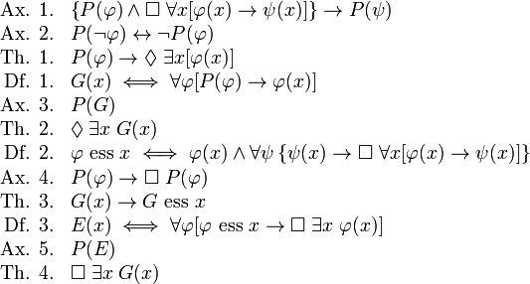
4 Argument

Slide 38
De Morgan's laws
De Morgan's laws are a pair of transformation rules that are both valid rules of inference. The rules allow the expression of conjunctions and disjunctions purely in terms of each other via negation.
The rules can be expressed in English as:
The negation of a conjunction is the disjunction of the negations. The negation of a disjunction is the conjunction of the negations.
or informally as:
"not (A and B)" is the same as "(not A) or (not B)" and also, "not (A or B)" is the same as "(not A) and (not B)".

Slide 39
De Morgan's laws

Slide 40
Boolean algebra
Boolean algebra is the subarea of algebra in which the values of the variables are the truth values true and false, usually denoted 1 and 0 respectively. Instead of elementary algebra where the values of the variables are numbers, and the main operations are addition and multiplication, the main operations of Boolean algebra are the conjunction and, denoted ∧, the disjunction or, denoted ∨, and the negation not, denoted ¬. It is thus a formalism for describing logical relations in the same way that ordinary algebra describes numeric relations.

Slide 41
Predicate
A predicate is commonly understood to be a Boolean-valued function P: X→ {true, false}, called the predicate on X. However, predicates have many different uses and interpretations in mathematics and logic, and their precise definition, meaning and use will vary from theory to theory. So, for example, when a theory defines the concept of a relation, then a predicate is simply the characteristic function or the indicator function of a relation. However, not all theories have relations, or are founded on set theory, and so one must be careful with the proper definition and semantic interpretation of a predicate.

Slide 42
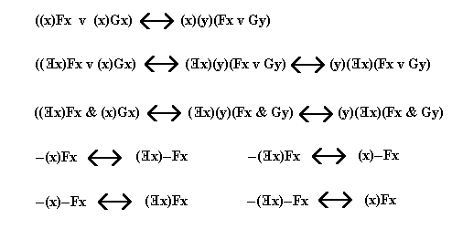
2 Predicate

