Slide 1
Predicate
Definition
Applications
Examples

Slide 2
Predicate
A predicate is commonly understood to be a Boolean-valued function P: X→ {true, false}, called the predicate on X. However, predicates have many different uses and interpretations in mathematics and logic, and their precise definition, meaning and use will vary from theory to theory. So, for example, when a theory defines the concept of a relation, then a predicate is simply the characteristic function or the indicator function of a relation. However, not all theories have relations, or are founded on set theory, and so one must be careful with the proper definition and semantic interpretation of a predicate.

Slide 3
Predicate
Informally, a predicate is a statement that may be true or false depending on the values of its variables. It can be thought of as an operator or function that returns a value that is either true or false. For example, predicates are sometimes used to indicate set membership: when talking about sets, it is sometimes inconvenient or impossible to describe a set by listing all of its elements. Thus, a predicate P(x) will be true or false, depending on whether x belongs to a set.
Predicates are also commonly used to talk about the properties of objects, by defining the set of all objects that have some property in common. So, for example, when P is a predicate on X, one might sometimes say P is a property of X. Similarly, the notation P(x) is used to denote a sentence or statement P concerning the variable object x. The set defined by P(x) is written as {x | P(x)}, and is just a collection of all the objects for which P is true.
For instance, {x | x is a positive integer less than 4} is the set {1,2,3}.
If t is an element of the set {x | P(x)}, then the statement P(t) is true.
Here, P(x) is referred to as the predicate, and x the subject of the proposition. Sometimes, P(x) is also called a propositional function, as each choice of x produces a proposition.

Slide 4
Formal definition
The precise semantic interpretation of an atomic formula and an atomic sentence will vary from theory to theory.
In propositional logic, atomic formulas are called propositional variables. In a sense, these are nullary (i.e. 0-arity) predicates.
In first-order logic, an atomic formula consists of a predicate symbol applied to an appropriate number of terms.
In set theory, predicates are understood to be characteristic functions or set indicator functions, i.e. functions from a set element to a truth value. Set-builder notation makes use of predicates to define sets.
In autoepistemic logic, which rejects the law of excluded middle, predicates may be true, false, or simply unknown; i.e. a given collection of facts may be insufficient to determine the truth or falsehood of a predicate.
In fuzzy logic, predicates are the characteristic functions of a probability distribution. That is, the strict true/false valuation of the predicate is replaced by a quantity interpreted as the degree of truth.

Slide 5
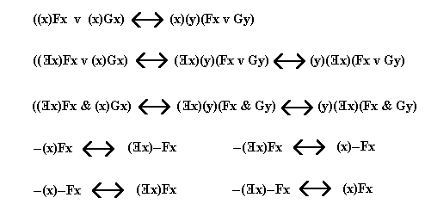
Predicate

Slide 6
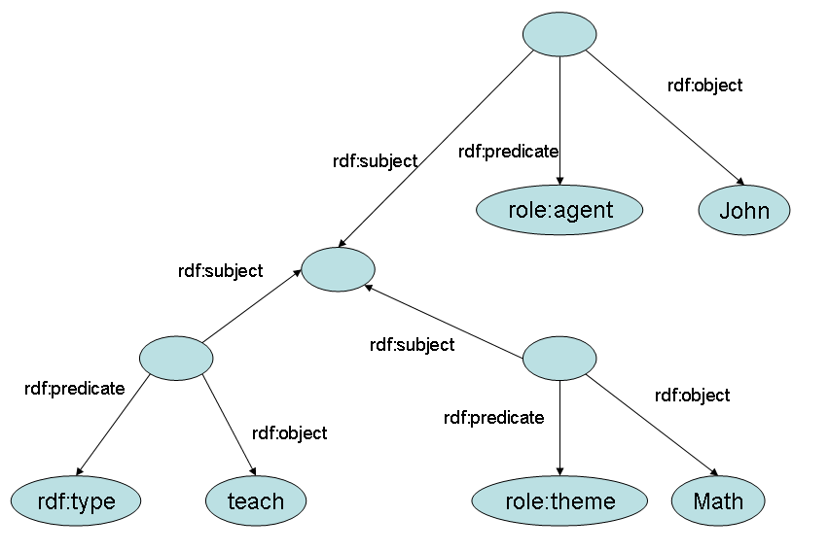
Predicate

Slide 7
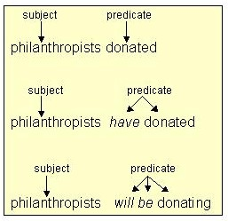
Predicate

Slide 8
References and bibliography
Cunningham, Daniel W. (2012). A Logical Introduction to Proof. New York: Springer. p. 29. ISBN 9781461436317.
Haas, Guy M. "What If? (Predicates)". Introduction to Computer Programming. Berkeley Foundation for Opportunities in IT (BFOIT),. Retrieved 20 July 2013.
Lavrov, Igor Andreevich and Larisa Maksimova (2003). Problems in Set Theory, Mathematical Logic, and the Theory of Algorithms. New York: Springer. p. 52. ISBN 0306477122.

