Slide 1
5 Lecture in math
Predicates
Induction
Combinatorics

Slide 2
Arithmetic of logic (tautology, contradiction, implication, double implication)

Slide 3
Linguistics math

Slide 4
Grammar predicates
There are two competing notions of the predicate in theories of grammar. The first concerns traditional grammar, which tends to view a predicate as one of two main parts of a sentence, the other part being the subject; the purpose of the predicate is to complete an idea about the subject, such as what it does or what it is like. The second derives from work in predicate calculus (predicate logic, first order logic) and is prominent in modern theories of syntax and grammar. In this approach, the predicate of a sentence corresponds mainly to the main verb and any auxiliaries that accompany the main verb, whereas the arguments of that predicate (e.g. the subject and object noun phrases) are outside the predicate. The competition between these two concepts has generated confusion concerning the use of the term predicate in theories of grammar.

Slide 5
Predicate
A predicate is commonly understood to be a Boolean-valued function P: X→ {true, false}, called the predicate on X. However, predicates have many different uses and interpretations in mathematics and logic, and their precise definition, meaning and use will vary from theory to theory. So, for example, when a theory defines the concept of a relation, then a predicate is simply the characteristic function or the indicator function of a relation. However, not all theories have relations, or are founded on set theory, and so one must be careful with the proper definition and semantic interpretation of a predicate.

Slide 6
Predicates
Analyze these expressions:
a. A cat is black.
b. A cat is white.
c. A cat is not black.
d. A cat is not white.

Slide 7
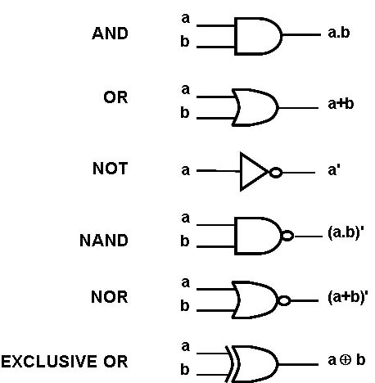

Slide 8
Induction vs. deduction philosophy

Slide 9
Mathematical induction
Mathematical induction is a method of mathematical proof typically used to establish a given statement for all natural numbers. It is a form of direct proof, and it is done in two steps. The first step, known as the base case, is to prove the given statement for the first natural number. The second step, known as the inductive step, is to prove that the given statement for any one natural number implies the given statement for the next natural number. From these two steps, mathematical induction is the rule from which we infer that the given statement is established for all natural numbers.
The method can be extended to prove statements about more general well-founded structures, such as trees; this generalization, known as structural induction, is used in mathematical logic and computer science. Mathematical induction in this extended sense is closely related to recursion. Mathematical induction, in some form, is the foundation of all correctness proofs for computer programs.
Although its name may suggest otherwise, mathematical induction should not be misconstrued as a form of inductive reasoning (also see Problem of induction). Mathematical induction is an inference rule used in proofs. In mathematics, proofs including those using mathematical induction are examples of deductive reasoning and inductive reasoning is excluded from proofs.

Slide 10
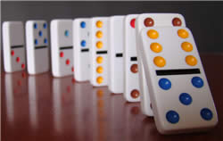

Slide 11
Combinatorics
Combinatorics is a branch of mathematics concerning the study of finite or countable discrete structures. Aspects of combinatorics include counting the structures of a given kind and size (enumerative combinatorics), deciding when certain criteria can be met, and constructing and analyzing objects meeting the criteria (as in combinatorial designs and matroid theory), finding "largest", "smallest", or "optimal" objects (extremal combinatorics and combinatorial optimization), and studying combinatorial structures arising in an algebraic context, or applying algebraic techniques to combinatorial problems (algebraic combinatorics).
Combinatorial problems arise in many areas of pure mathematics, notably in algebra, probability theory, topology, and geometry, and combinatorics also has many applications in mathematical optimization, computer science, ergodic theory and statistical physics. Many combinatorial questions have historically been considered in isolation, giving an ad hoc solution to a problem arising in some mathematical context. In the later twentieth century, however, powerful and general theoretical methods were developed, making combinatorics into an independent branch of mathematics in its own right. One of the oldest and most accessible parts of combinatorics is graph theory, which also has numerous natural connections to other areas. Combinatorics is used frequently in computer science to obtain formulas and estimates in the analysis of algorithms.
A mathematician who studies combinatorics is called a combinatorialist or a combinatorist.

Slide 12
Tossing coins

Slide 13
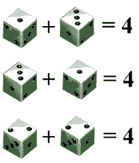

Slide 15
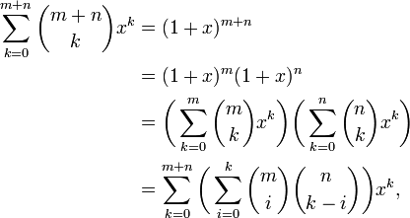

Slide 16
Pigeonhole Principle
The pigeonhole principle states that if n items are put into m containers, with n > m, then at least one container must contain more than one item. This theorem is exemplified in real-life by truisms like "there must be at least two left gloves or two right gloves in a group of three gloves". It is an example of a counting argument, and despite seeming intuitive it can be used to demonstrate possibly unexpected results; for example, that two people in London have the same number of hairs on their heads

Slide 17
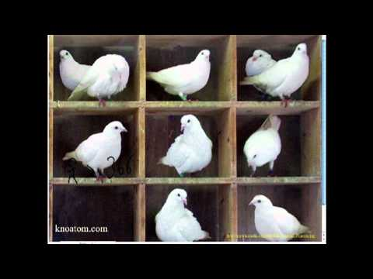

Slide 18
Graph theory
Graph theory is the study of graphs, which are mathematical structures used to model pairwise relations between objects. A "graph" in this context is made up of "vertices" or "nodes" and lines called edges that connect them. A graph may be undirected, meaning that there is no distinction between the two vertices associated with each edge, or its edges may be directed from one vertex to another; see graph (mathematics) for more detailed definitions and for other variations in the types of graph that are commonly considered. Graphs are one of the prime objects of study in discrete mathematics.

Slide 19
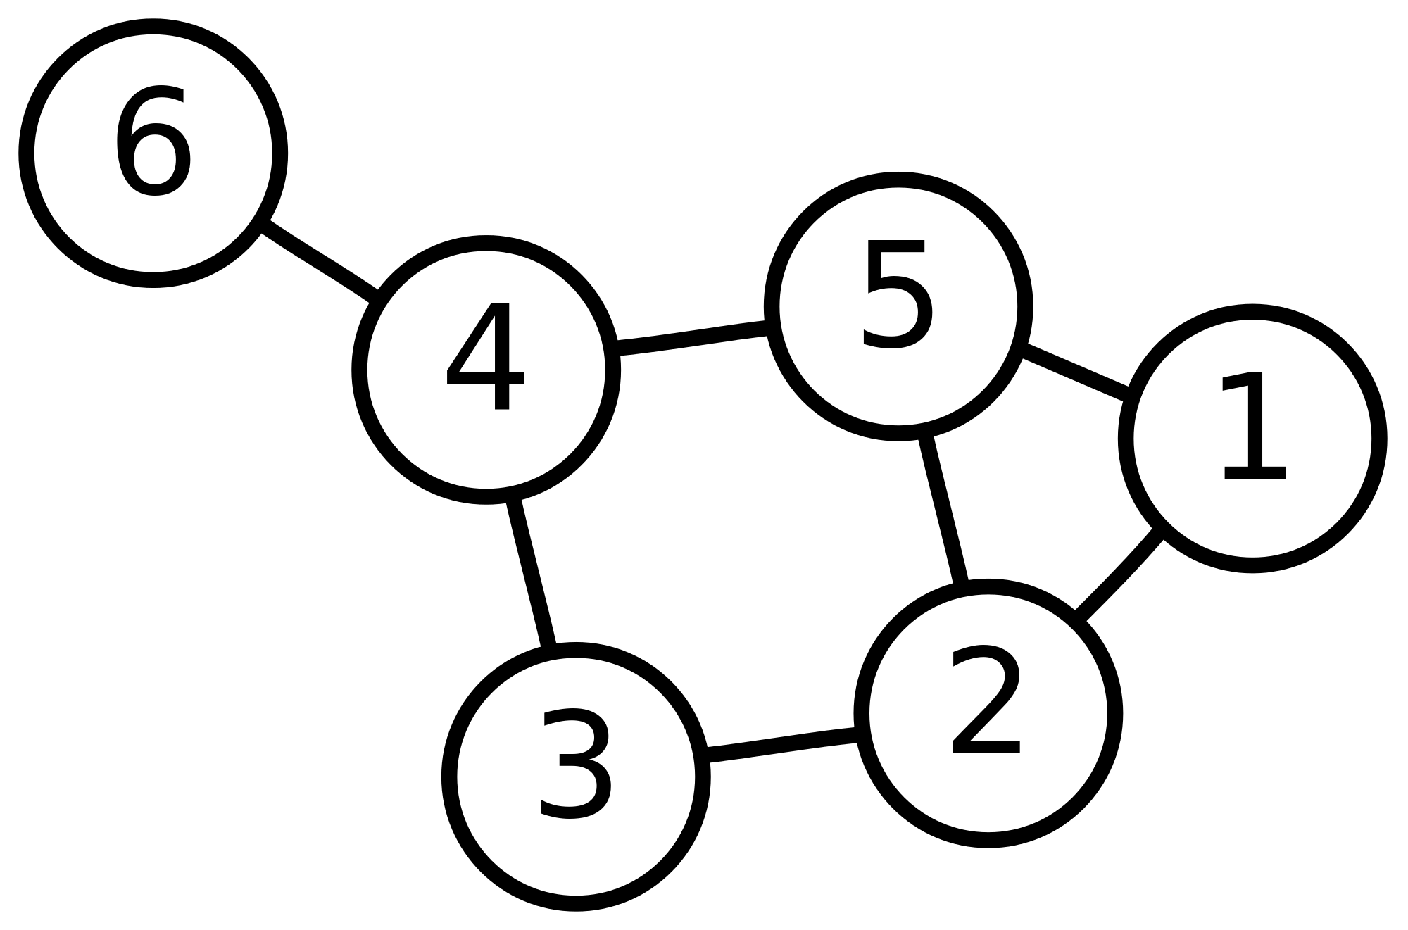

Slide 20
Why do you personally need math?

Slide 21
5 Math exercises
1. Represent implication as a combination of not, or.
2. Analyze these expressions:
a. A cat is black.
b. A cat is white.
c. A cat is not black.
d. A cat is not white.
3. Why do you personally need math?
4. Prepare to the Mid-Term Exam by revising everything you studied this semester.

Slide 22
Debate competitions
Debate competitions are 5% of our scores.
Attend the debate competition these Tuesday and Wednesday
Use your math knowledge in the debate

