Slide 1
3 Lecture in math
Sets theory

Slide 2
Set theory
Set theory is the branch of mathematical logic that studies sets, which are collections of objects. Although any type of object can be collected into a set, set theory is applied most often to objects that are relevant to mathematics. The language of set theory can be used in the definitions of nearly all mathematical objects.

Slide 3
Set theory (continued)
The modern study of set theory was initiated by Georg Cantor and Richard Dedekind in the 1870s. After the discovery of paradoxes in naive set theory, numerous axiom systems were proposed in the early twentieth century, of which the Zermelo–Fraenkel axioms, with the axiom of choice, are the best-known.

Slide 4
(continued) Set theory
Set theory is commonly employed as a foundational system for mathematics, particularly in the form of Zermelo–Fraenkel set theory with the axiom of choice. Beyond its foundational role, set theory is a branch of mathematics in its own right, with an active research community. Contemporary research into set theory includes a diverse collection of topics, ranging from the structure of the real number line to the study of the consistency of large cardinals.

Slide 5
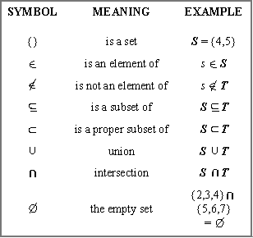
Set theory (continued)

Slide 6
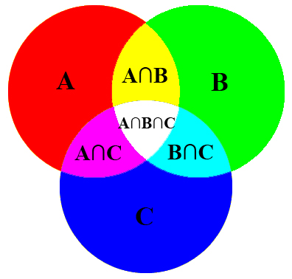
(continued) Set theory

Slide 7
Cardinality
The cardinality of a set is a measure of the "number of elements of the set". For example, the set A = {2, 4, 6} contains 3 elements, and therefore A has a cardinality of 3. There are two approaches to cardinality – one which compares sets directly using bijections and injections, and another which uses cardinal numbers. The cardinality of a set is also called its size, when no confusion with other notions of size is possible.
The cardinality of a set A is usually denoted | A |, with a vertical bar on each side; this is the same notation as absolute value and the meaning depends on context. Alternatively, the cardinality of a set A may be denoted by n(A), A, card(A), or # A.

Slide 8
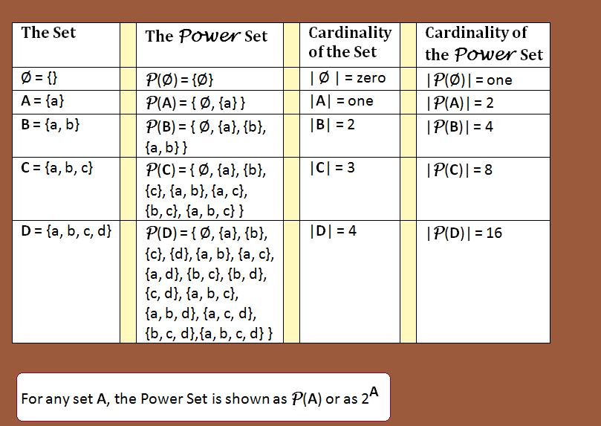
Cardinality (continued)

